Slide 1
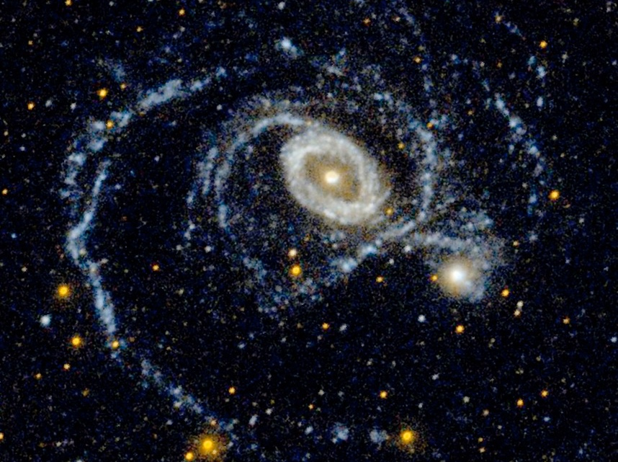
GaAs(P)-based Detector Alternatives for the WFIRST Coronagraph
Patrick Morrissey
Flight Instrument Detectors and Camera Systems
Section 389N
31 January 2017

Slide 2
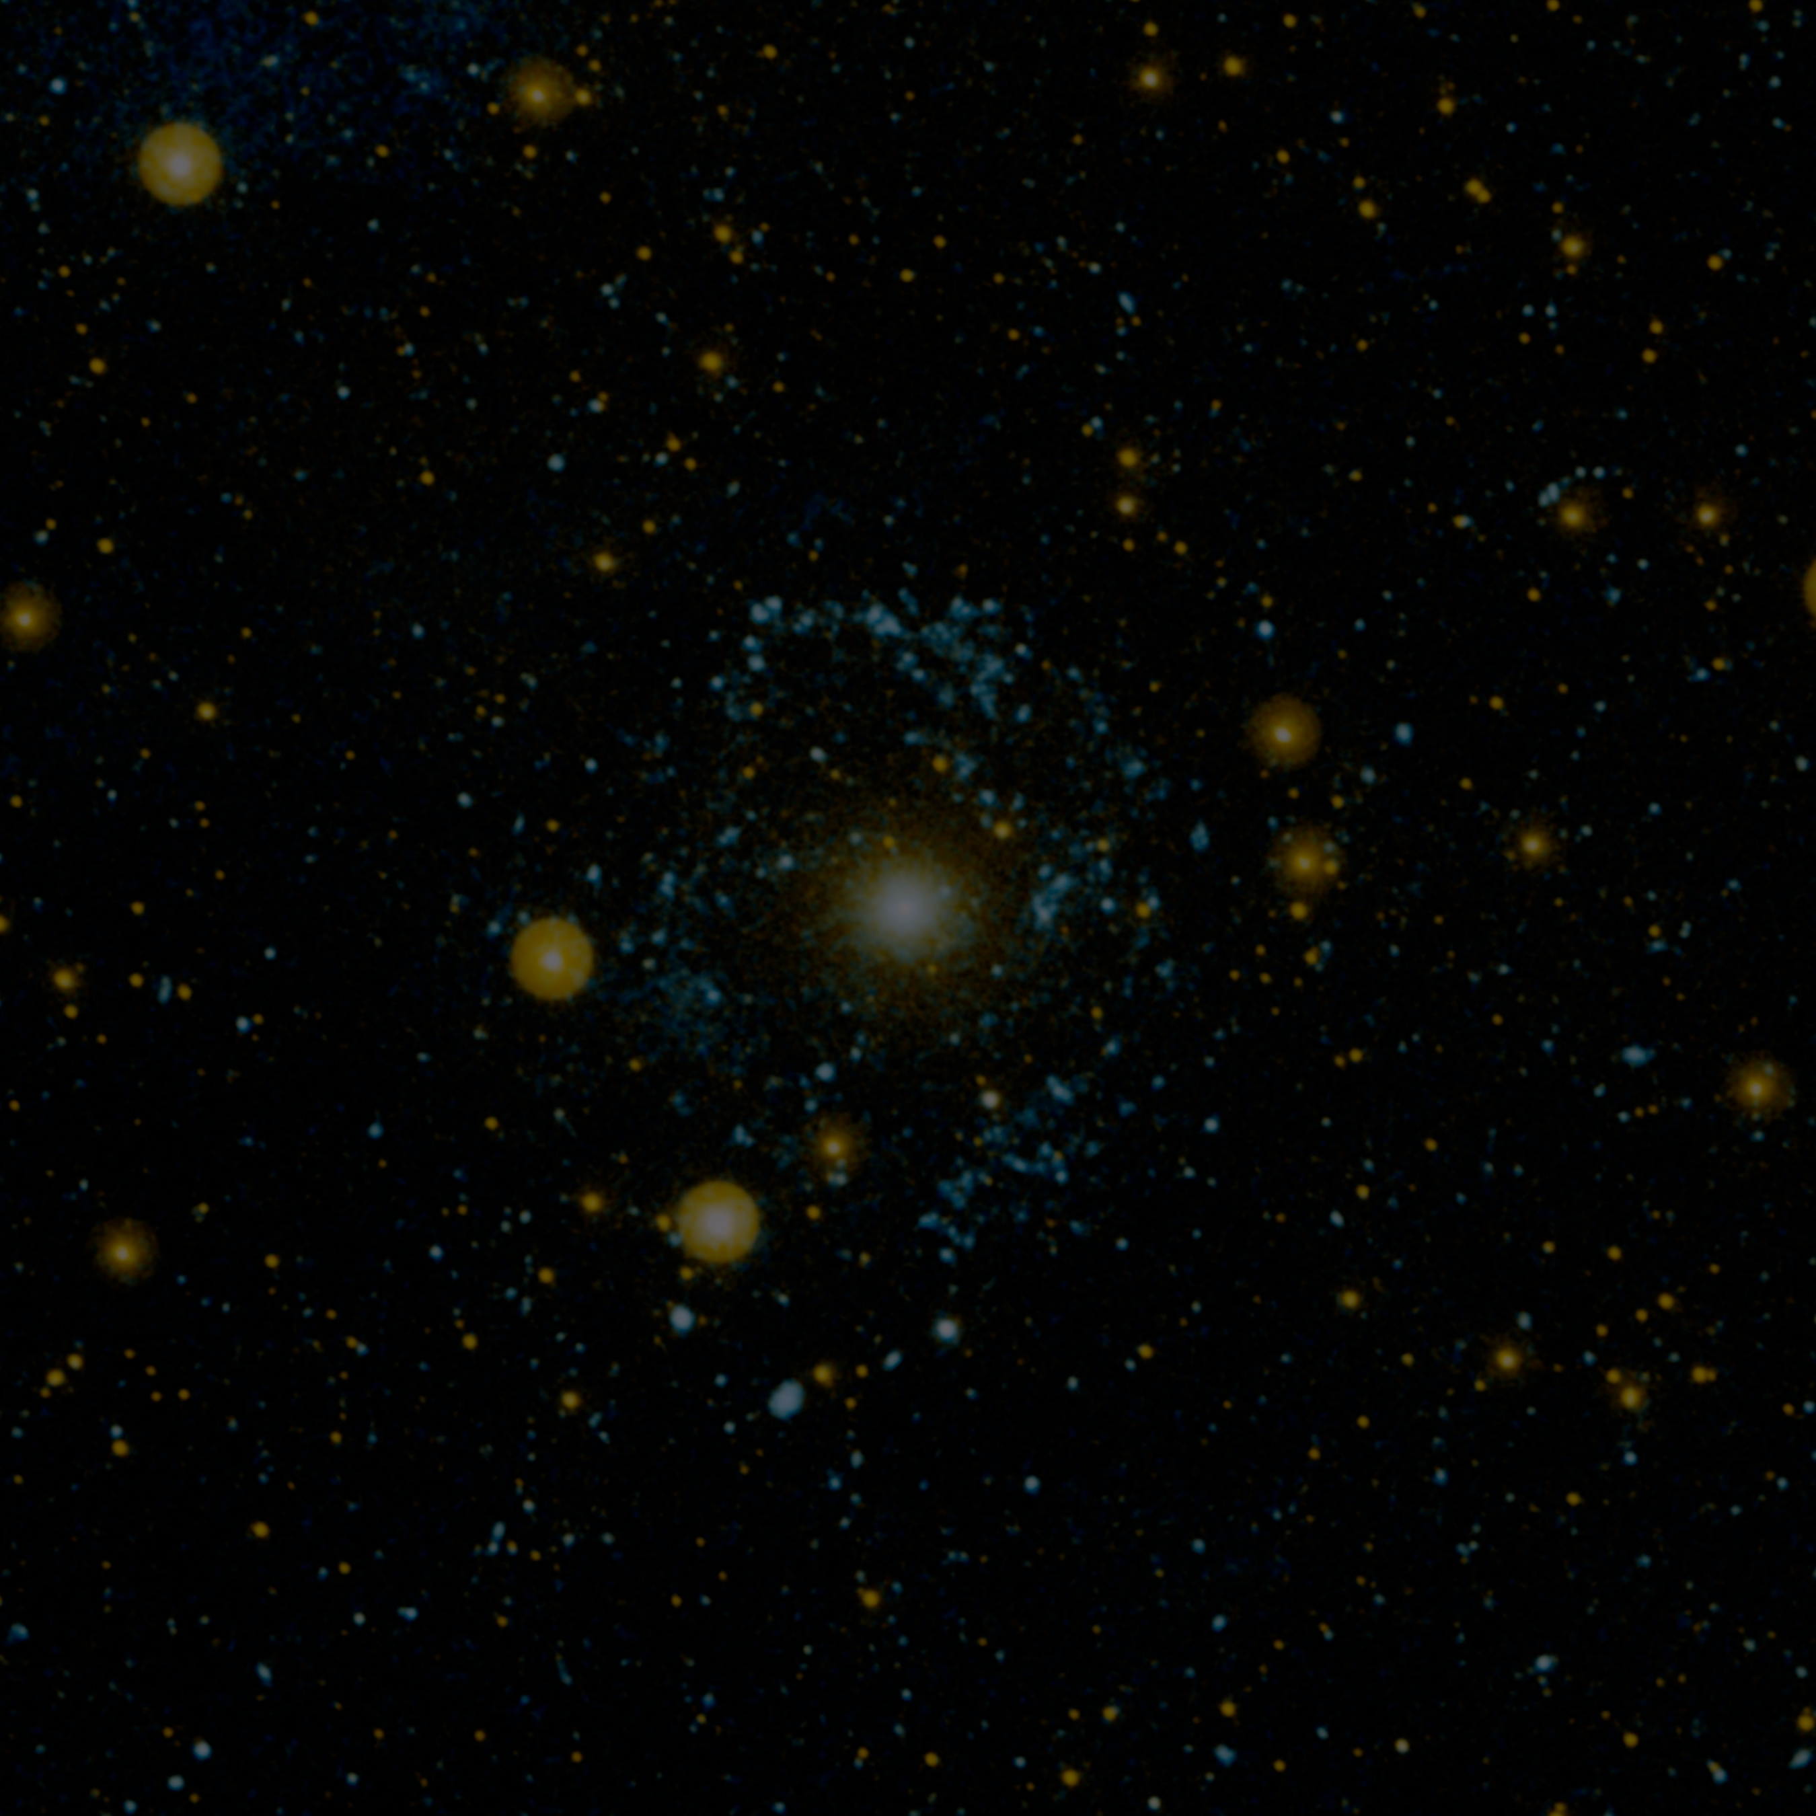
Outline
Detector Requirements
Contextual summary of L3CCD design and measurements, and HST experience
A primer on risk and detector lifetime with respect to radiation and radiation shielding
Alternate competitive detector concepts
MCP designs
Electron-bombarded CCD/CMOS
Discussion of design maturity and TRL
Pros and Cons
Recommendations

Slide 3
Outline
Detector Requirements
Contextual summary of L3CCD design and measurements, and HST experience
A primer on risk and detector lifetime with respect to radiation and radiation shielding
Alternate competitive detector concepts
MCP designs
Electron-bombarded CCD/CMOS
Discussion of design maturity and TRL
Pros and Cons
Recommendations

Slide 4
Requirements and Motivation
The WFIRST coronagraph will directly image a planet in the vicinity of a nearby star. The predicted signal is exceedingly faint, and beyond the reach of typical detectors.
Requirements for this technology demonstration are in development with the science team, with a goal of setting threshold requirements that are capability-based.
Compare these to typical dark currents of 1-2 e-px⁻¹-hr⁻¹
Lifetime: 6 years
Band of interest: 450-950nm
Detection to S/N=5 (Nemati):
IFS1: 4.0e-4 e-px⁻¹-s⁻¹ (4 days)
Imaging2: 4.6e-3 e-px⁻¹-s⁻¹ (1 day)

Slide 5
Outline
Detector Requirements
Contextual summary of L3CCD design and measurements, and HST experience
A primer on risk and detector lifetime with respect to radiation and radiation shielding
Alternate competitive detector concepts
MCP designs
Electron-bombarded CCD/CMOS
Discussion of design maturity and TRL
Pros and Cons
Recommendations

Slide 6
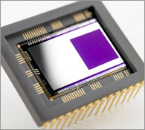
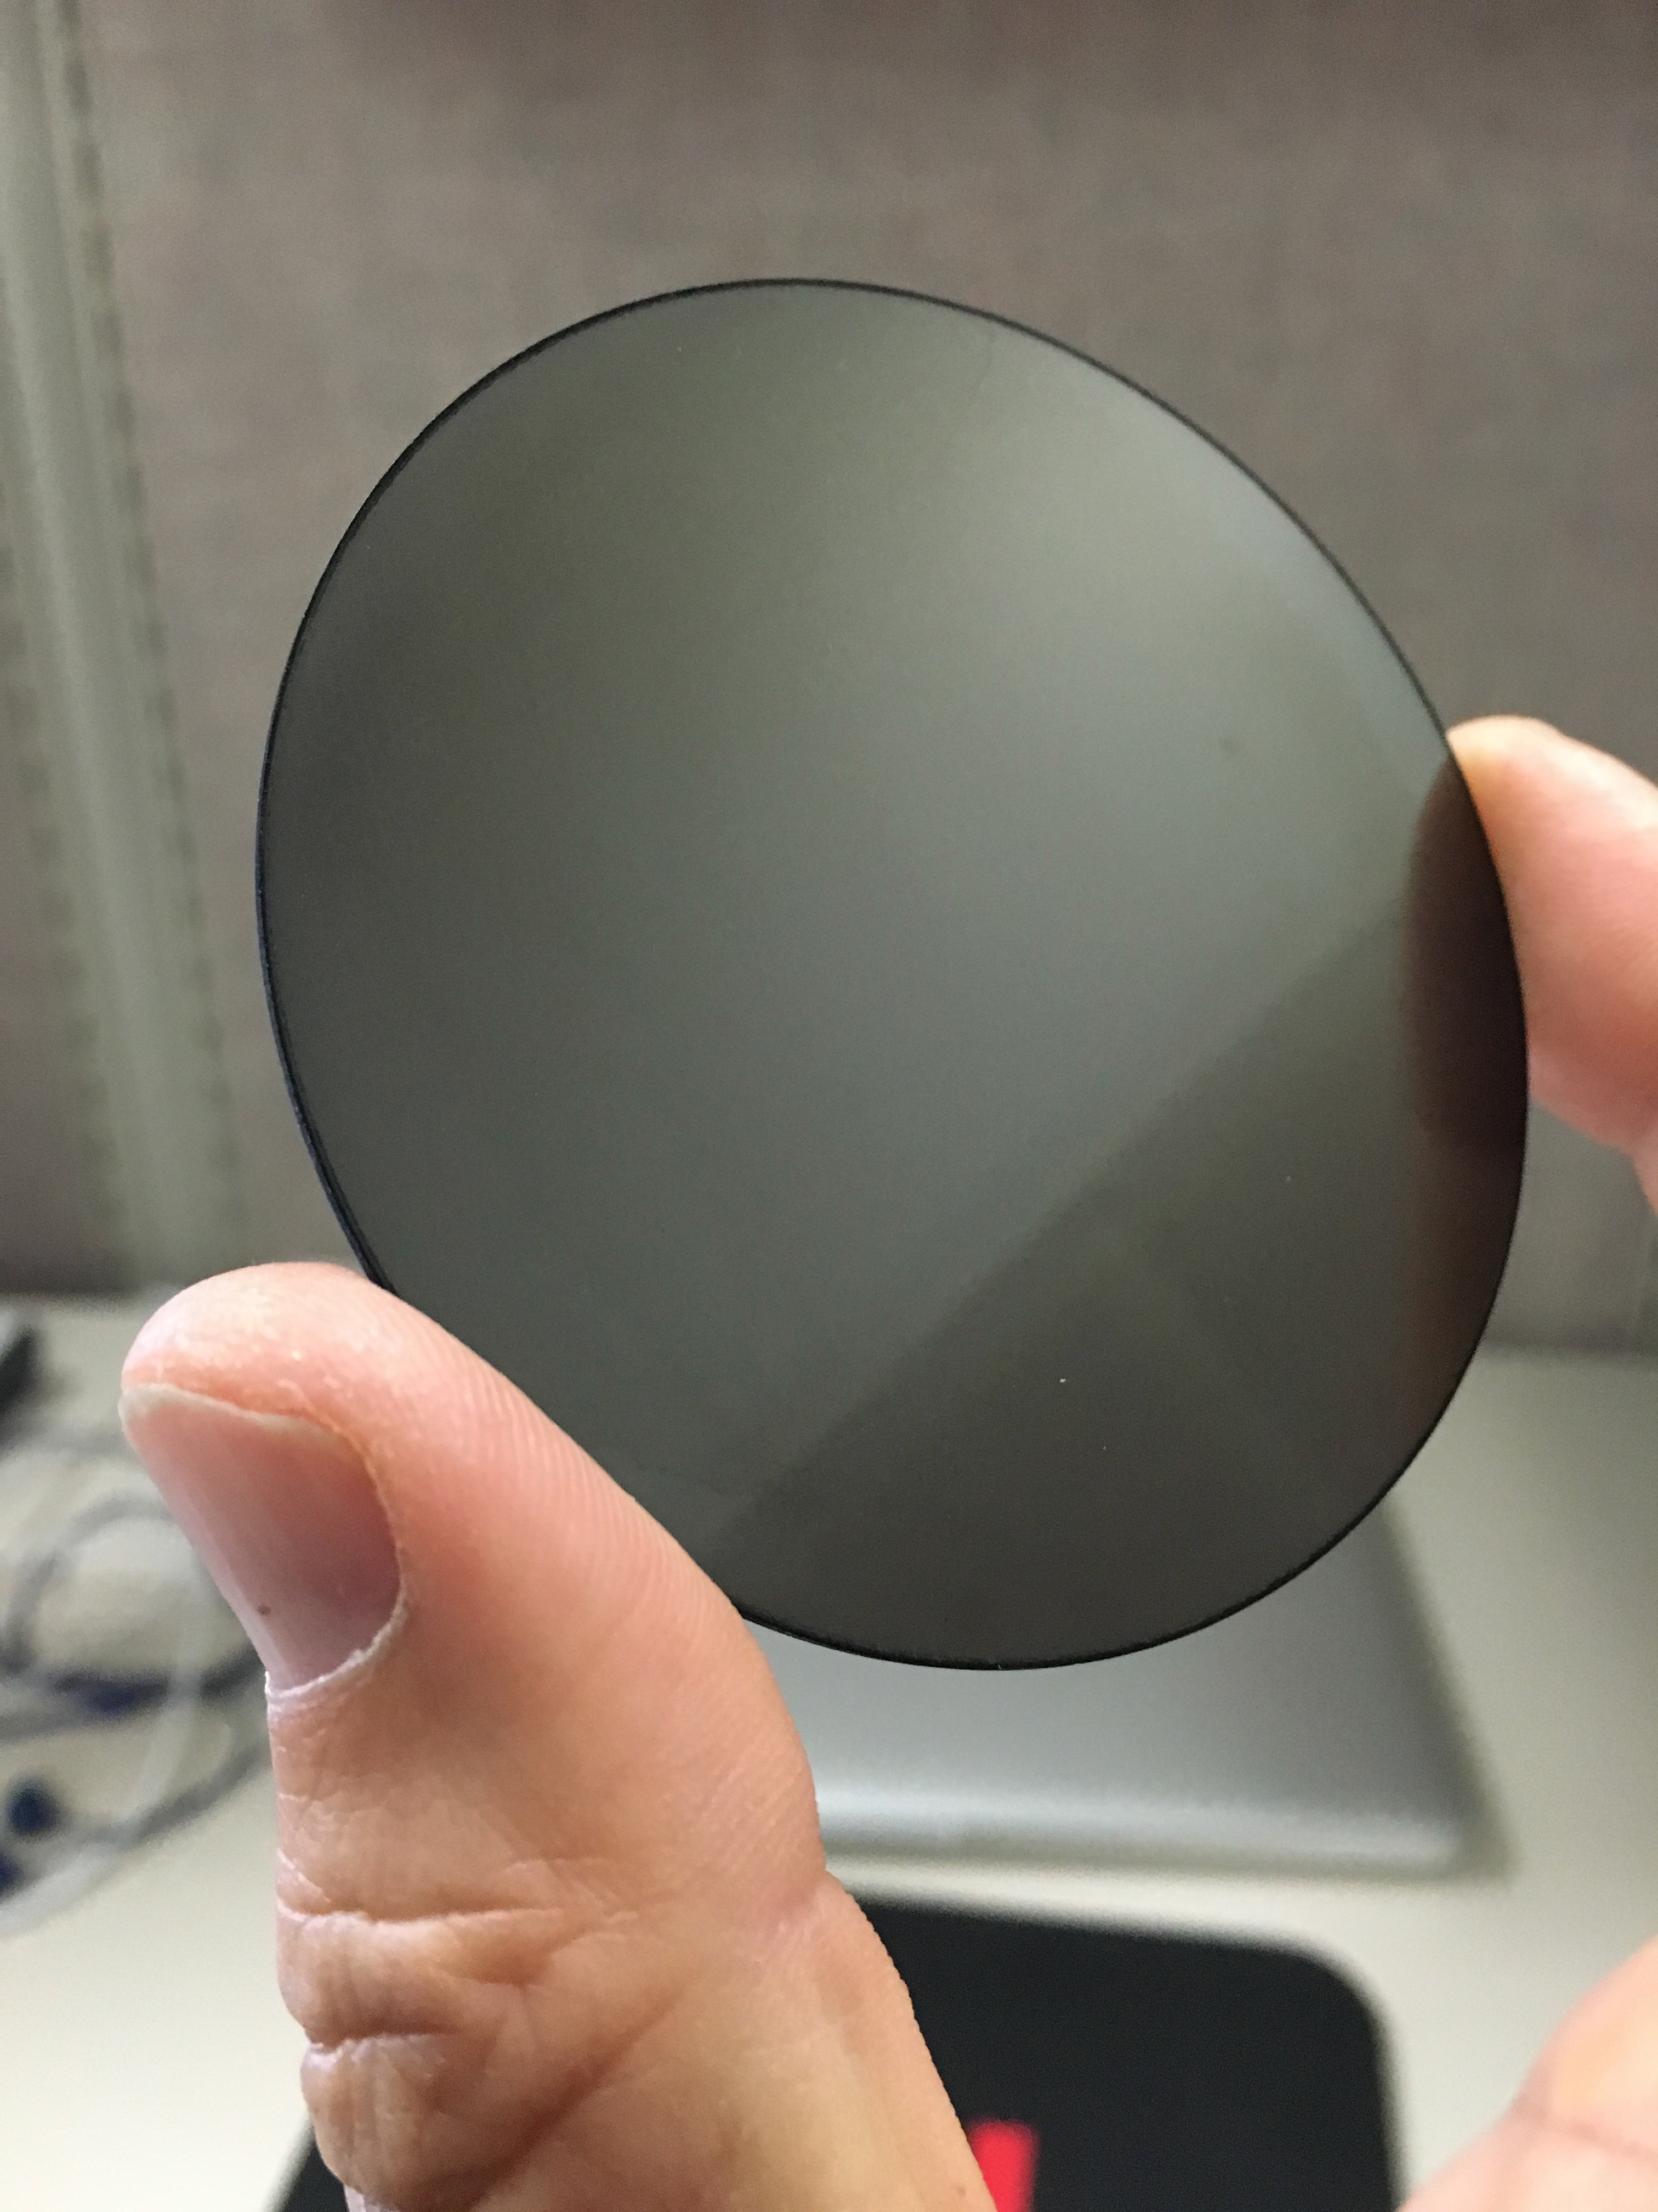
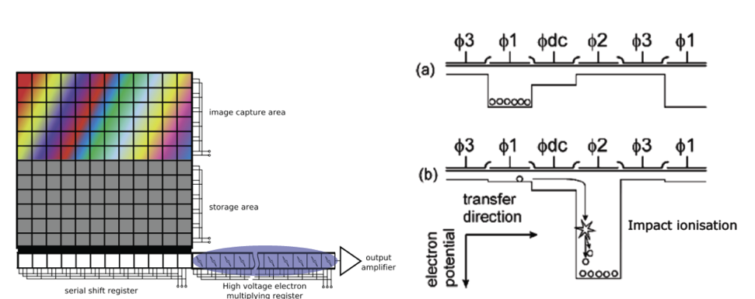
L3CCD Concept
MCP Intensifier
e2v L3 Technology
New technology from e2v enables high QE CCD imaging and zero read noise photon counting.
A Low Light Level (L3) extended serial register operating at elevated voltage (~50V) amplifies signals well above the level of the read noise.
GALEX MCP
Data Flow
Storage Area
Image Area
L3 functional diagram
Serial register
Photon input
Extended serial register (50V)
Amplified data is sent to a photon counting
discriminator, eliminating read noise.
L3CCD provides
High QE
Low dark current
…without HV!

Slide 7
HST WFC3 Experience: Charge Transfer Efficiency Degrades with Radiation
A deep image with high background
A shallow image with low background
A shallow image with LED post-flash
WFC3 Instrument Handbook
?
NOT ALLOWED for PHOTON COUNTING

Slide 8
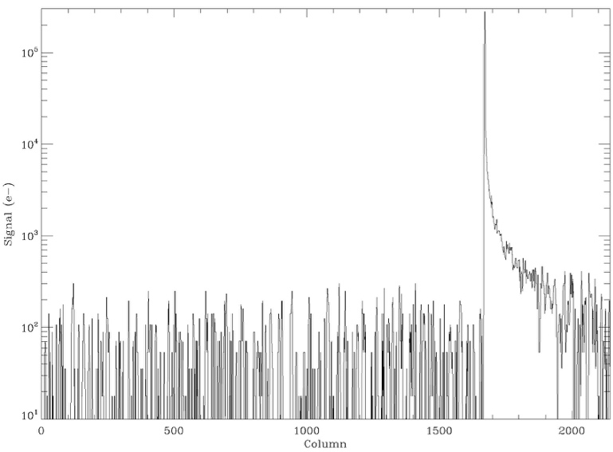
Cosmic Ray Tails
Full frame science-grade CCD201 image.
Temp = -85 °C (188 K)
Gain = 500
Exposure = 500s
Read Noise = 90e⁻
Cosmic ray tails and the requirements of photon counting (<0.1 photons-s⁻¹-pixel⁻¹) push the L3CCD to short frame times, while radiation damage pushes the L3CCD to long frame times.
100,000e⁻ (200e- equiv)
10,000e⁻
1,000e⁻
100e⁻
HST
Image courtesy L. Harding

Slide 9
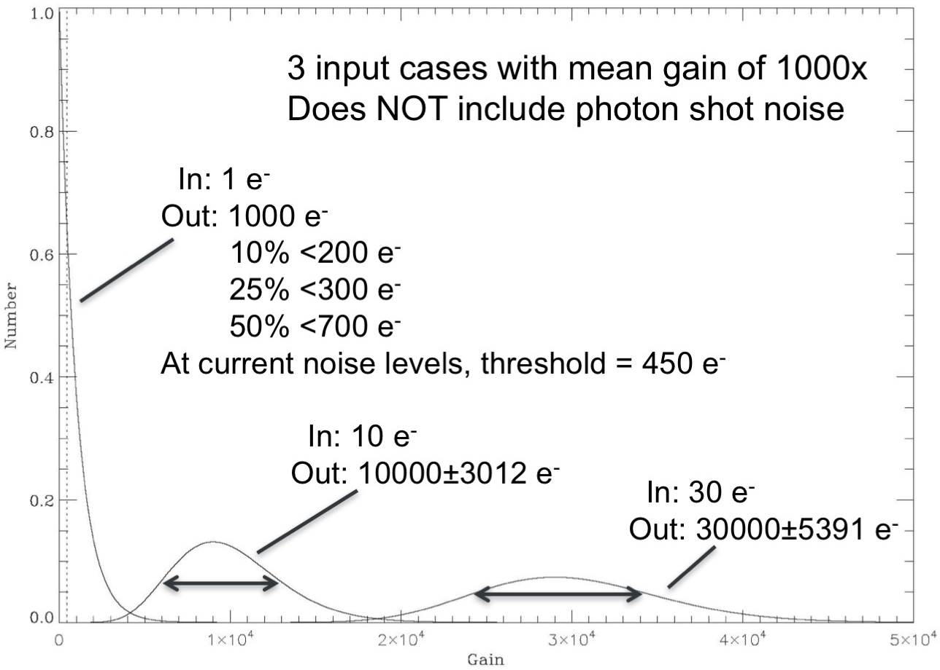
Cosmic Rays Tails Are Mitigated by Photon Counting at the Expense of Increased CIC
*CIC effectively sets a dark current floor of 0.14 e⁻-px⁻¹-hr⁻¹
Limiting noise is shown in RED.
 | Long Frames | Short Frames
Mode | EM Analog | EM Analog | Photon Counting
Effective QE | 0.45 | 0.45 | 0.75
Total Exposure | 100000 s
Frame Time | 2000 s | 20 s | 20 s
Frames | 50 | 5000 | 5000
Read Noise (90e-) | ±1.3 e⁻ | ±13 e⁻ | 0 e⁻
*CIC (3e-3 e⁻-px⁻¹-fr⁻¹) | 0.15 e⁻ | 15±3.9 e⁻ | 15±3.9 e⁻
Dark Current (2 e⁻-px⁻¹-hr⁻¹) | 55±7.4 e⁻ | 55±7.4 e⁻ | 55±7.4 e⁻
Gain | 500 | 1000 | 1000
Detection Limit (5σ) | CR-limited | 77 e⁻ | 42 e⁻

Slide 10
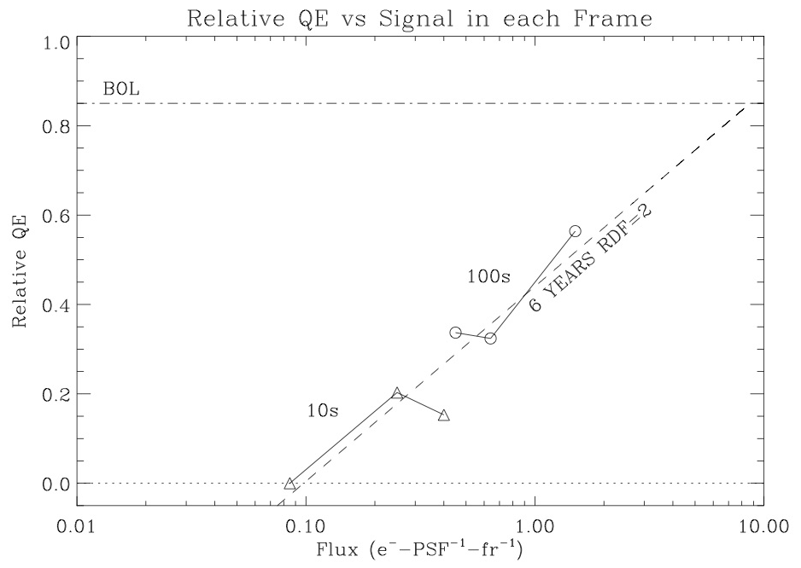
L3CCD Relative QE vs Flux
At beginning of life, detector appears to be linear to the lowest levels of flux we have attempted.
Questions:
How does non-linearity affect the interpretation of spectral features?
How will we know the extent of the non-linearity during the mission?
At end of life, detector becomes non-linear due to the subtractive action of traps on the signal.

Slide 11
Outline
Detector Requirements
Contextual summary of L3CCD design and measurements, and HST experience
A primer on risk and detector lifetime with respect to radiation and radiation shielding
Alternate competitive detector concepts
MCP designs
Electron-bombarded CCD/CMOS
Discussion of design maturity and TRL
Pros and Cons
Recommendations

Slide 12
LEO vs L2
HST Orbit
L2 Orbit@235Re
2
4
6
HST and CGI are in very different environments
Lunar Orbit@60Re
 | E>10MeV Trapped and Solar Protons | E>10MeV GCR
 | 7 year fluence (p-cm⁻²)
HST | 1.13e11 | 2.8e8
L2 | 6.48e11 | 9.8e8

Slide 13
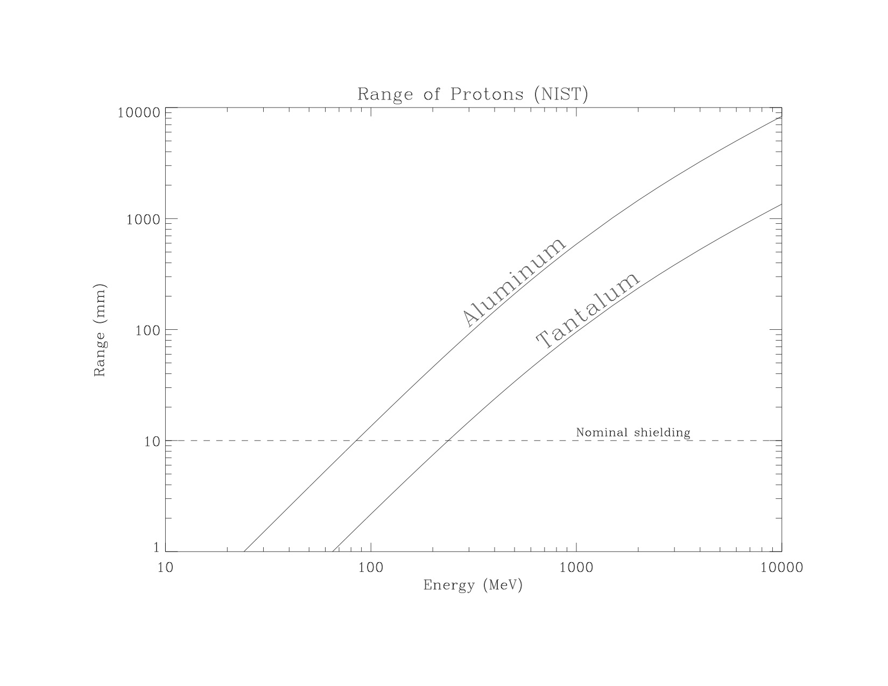
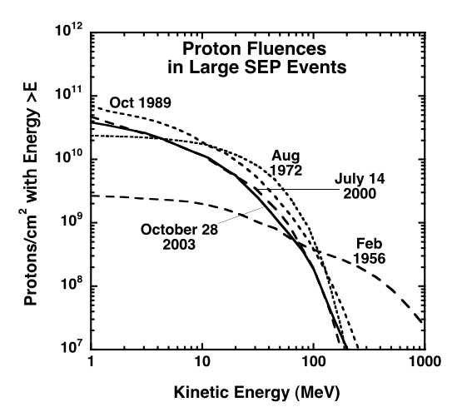
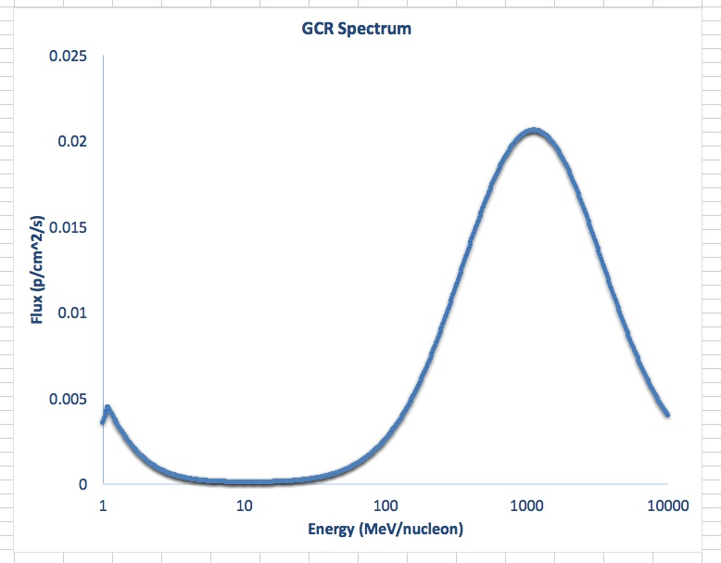
Range of Protons in Matter
Mewaldt 2005
Solar
GCR
Nominal Shielding

Slide 14
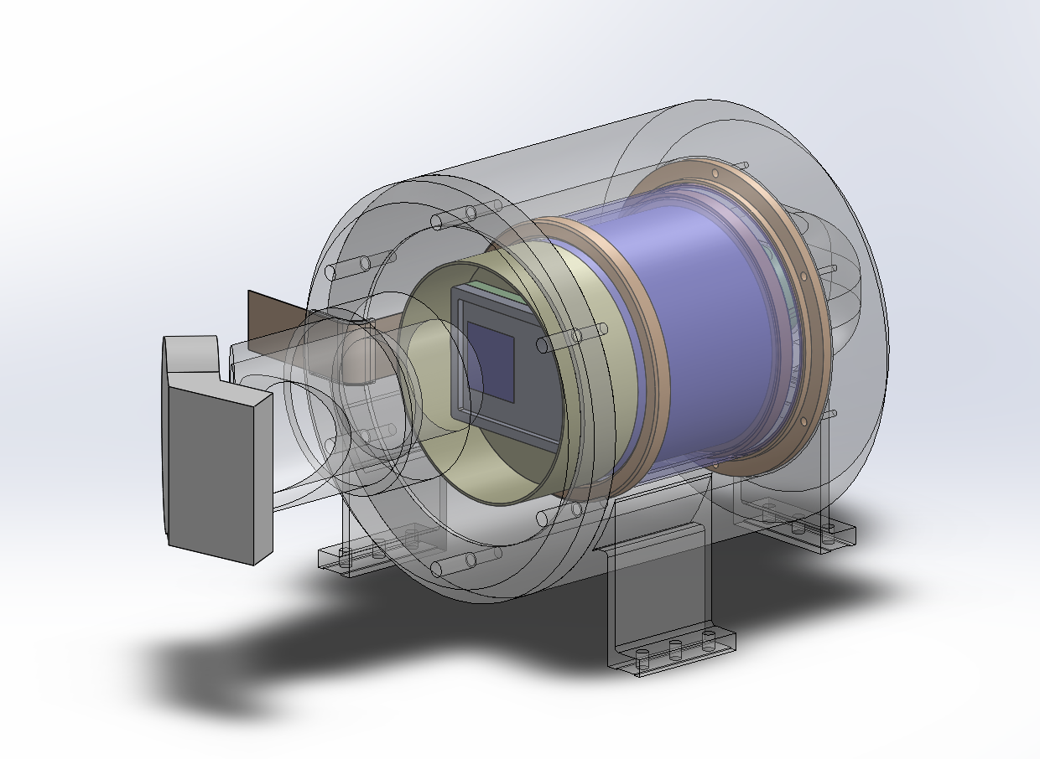
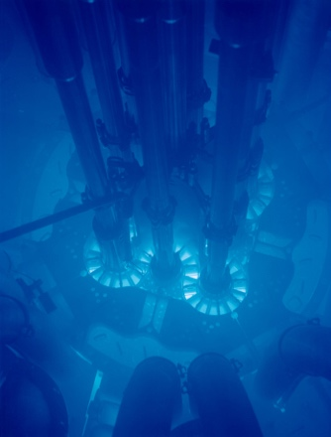
WFIRST CGI Radiation Shield Concept
Completely enclosed, 1cm Ta Shield Concept
Light enters, but energetic particles do not have a direct path to CCD
Scattered electrons appear to require a window somewhere
Secondary production is currently under investigation (Bremsstrahlung, Cerenkov, etc)
We are attempting to optimize the shield thickness against the production of secondary particles.
Solar
EMCCD
Light
Nuclear Reactor
Cerenkov Glow
Nominal Shielding

Slide 15
Outline
Detector Requirements
Contextual summary of L3CCD design and measurements, and HST experience
A primer on risk and detector lifetime with respect to radiation and radiation shielding
Alternate competitive detector concepts
MCP designs
Electron-bombarded CCD/CMOS
Discussion of design maturity and TRL
Pros and Cons
Recommendations

Slide 16
An MCP Intensified Alternative
PRO
Flight heritage
Rad hard
Low noise
CON
Modest QE
High voltage
Three parts
Laboratory performance of this rugged, flight-proven design will be representative of flight performance at T+6 years in the absence of any catastrophic failure.

Slide 17
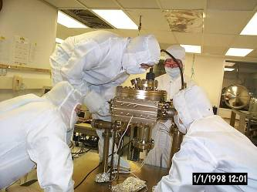
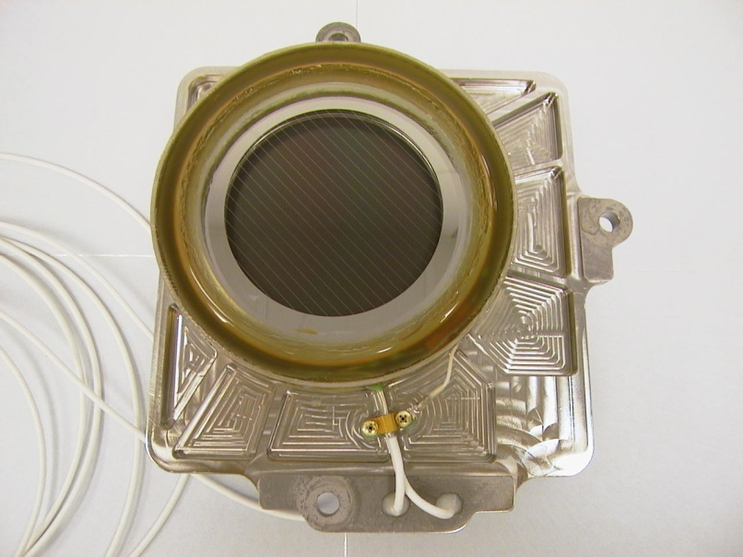
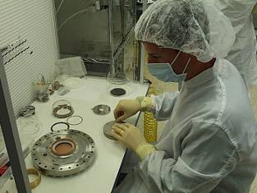
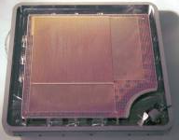
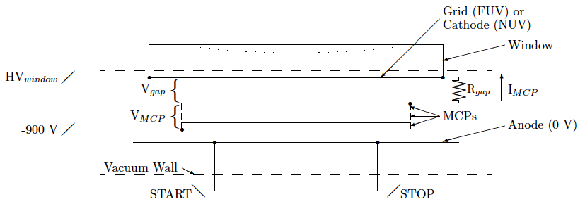
GALEX MCP Detector
70mm

Slide 18
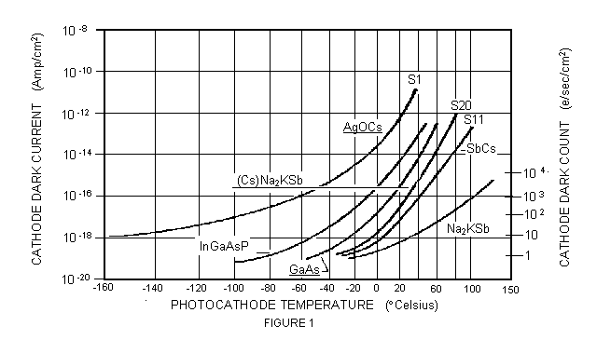
MCP Intensifier Performance
QE
DARK
A GaAsP (-74) Intensifier operating at -20 °C will have a visible band QE (cathode) of up to 50% and a dark current of 30 c-s⁻¹-cm⁻², which scales to an equivalent CCD dark of 0.18 c-px⁻¹-hr⁻¹.

Slide 19
Detector Noise vs Quantum Efficiency
(it all depends on what dark the EMCCD can achieve)
Consider the S/N of a moderate QE MCP detector vs a high QE EMCCD:
SN_{mcp}= QE_{mcp}*I/[QE_{mcp}*I + RN²_{mcp} + D_{mcp}]^{0.5}
SN_{ccd}= QE_{ccd}*I/[QE_{ccd}*I + RN²_{ccd} + CIC_{ccd} + D_{ccd}]^{0.5}
0
0
Low signal limit:
SN_{mcp}/SN_{ccd} = QE_{mcp}/QE_{ccd} * [CIC_{ccd} + D_{ccd}]^{0.5}/D_{mcp}^{0.5}
and if CIC can be neglected as well,
SN_{mcp}/SN_{ccd} = QE_{mcp}/QE_{ccd} * [D_{ccd}/D_{mcp}]^{0.5}= 0.3*3 = 1
What is D_{ccd}?

Slide 20
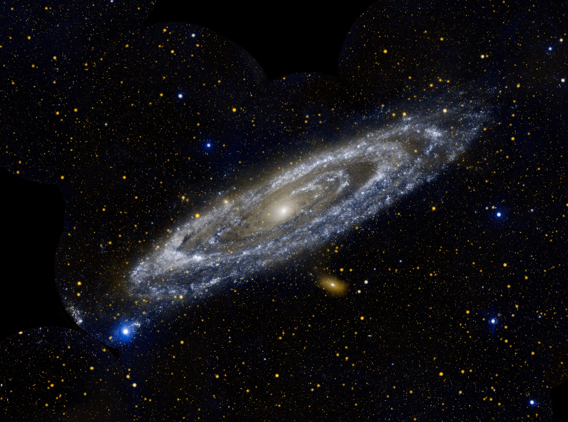
M31

Slide 21
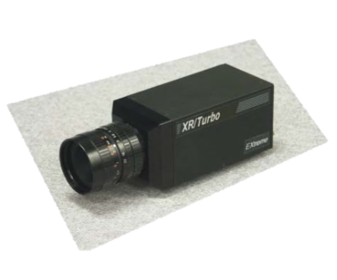
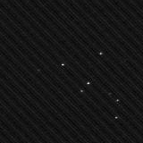
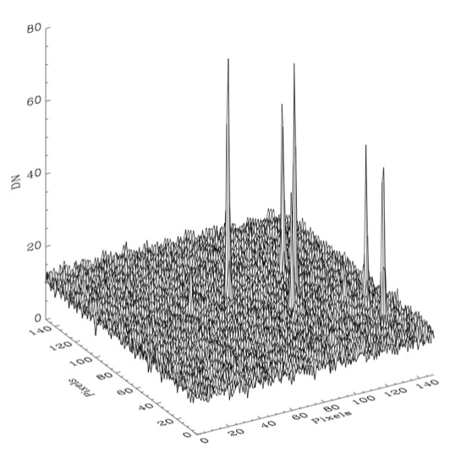
iCCD Laboratory Evaluation 1
We have identified a commercial iCCD camera with a GaAsP (optical) cathode that runs at -20 C and 120 fps (640x480). The active area of the detector is 12.8x9.6mm, comparable to the e2v CCD201.
Other cathodes are available and could be special ordered.
Dark frame test data confirms a rate of 29.5 c/s/cm², which scales to 0.18 c-px⁻¹-hr⁻¹ (very low!) in a 13 𝜇m square pixel. This is at least as good as the beginning-of-life dark current of the CCD. Unlike the CCD, MCP dark will not degrade during the mission lifetime.

Slide 22
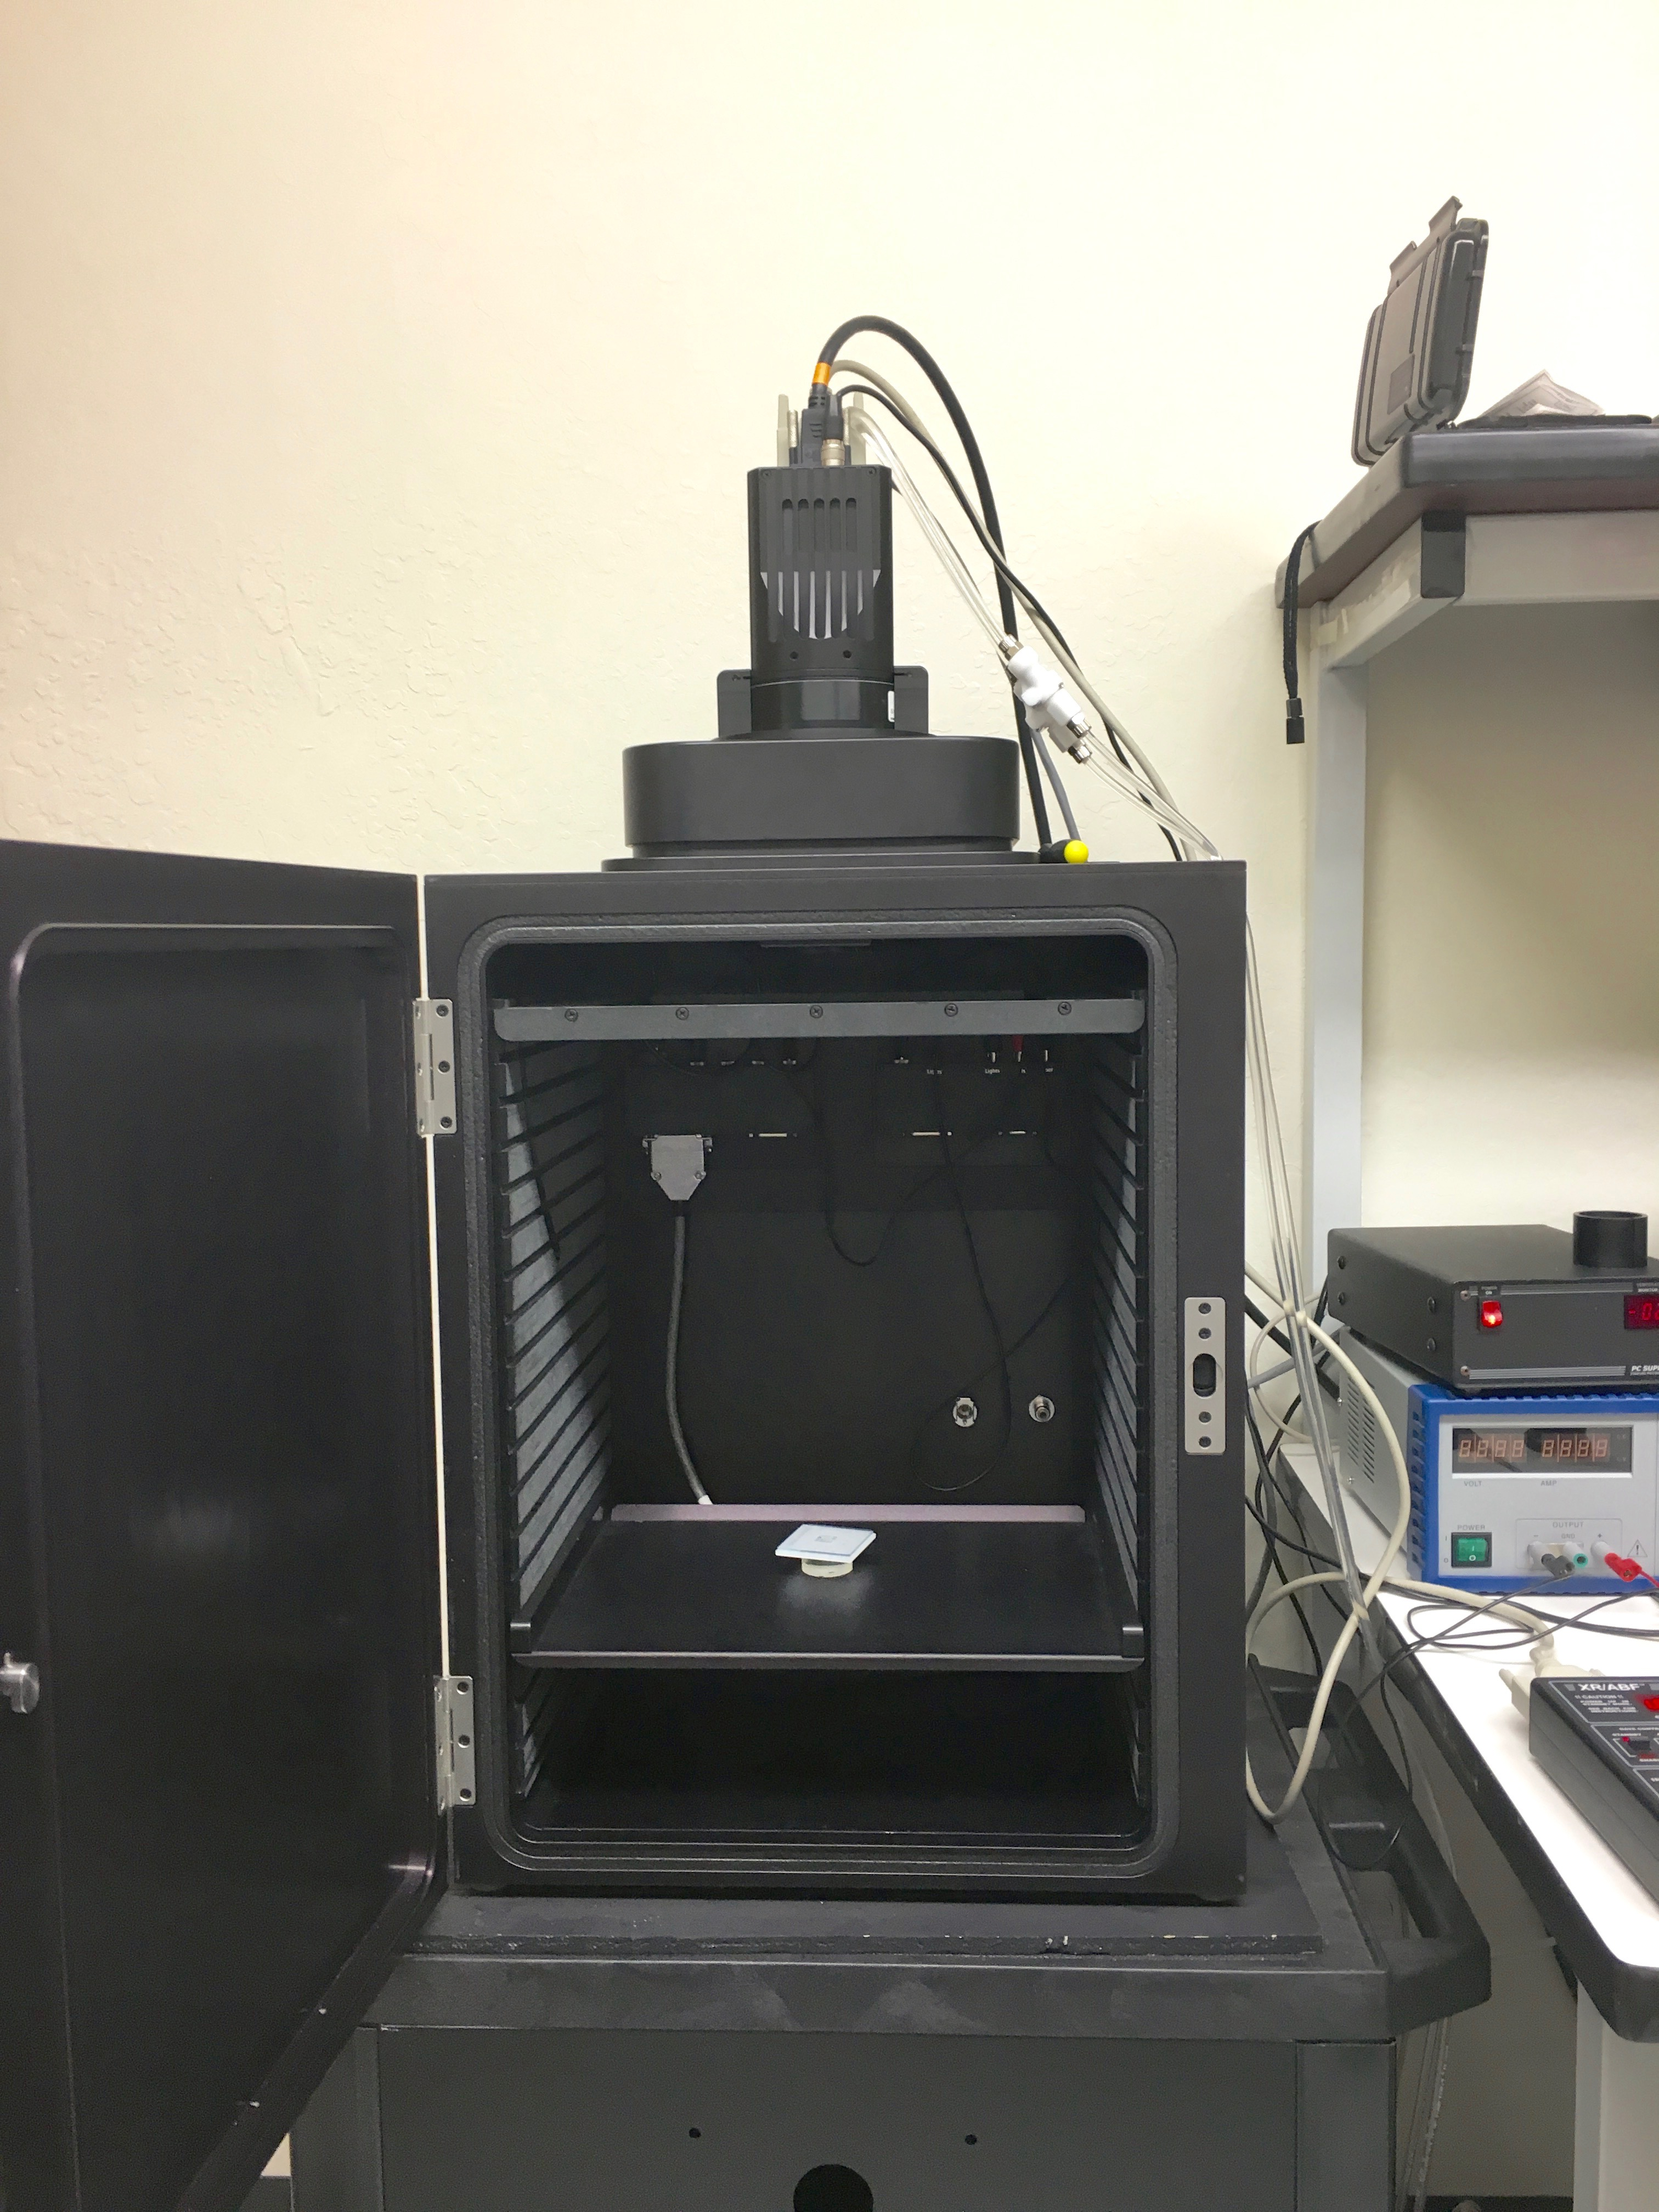
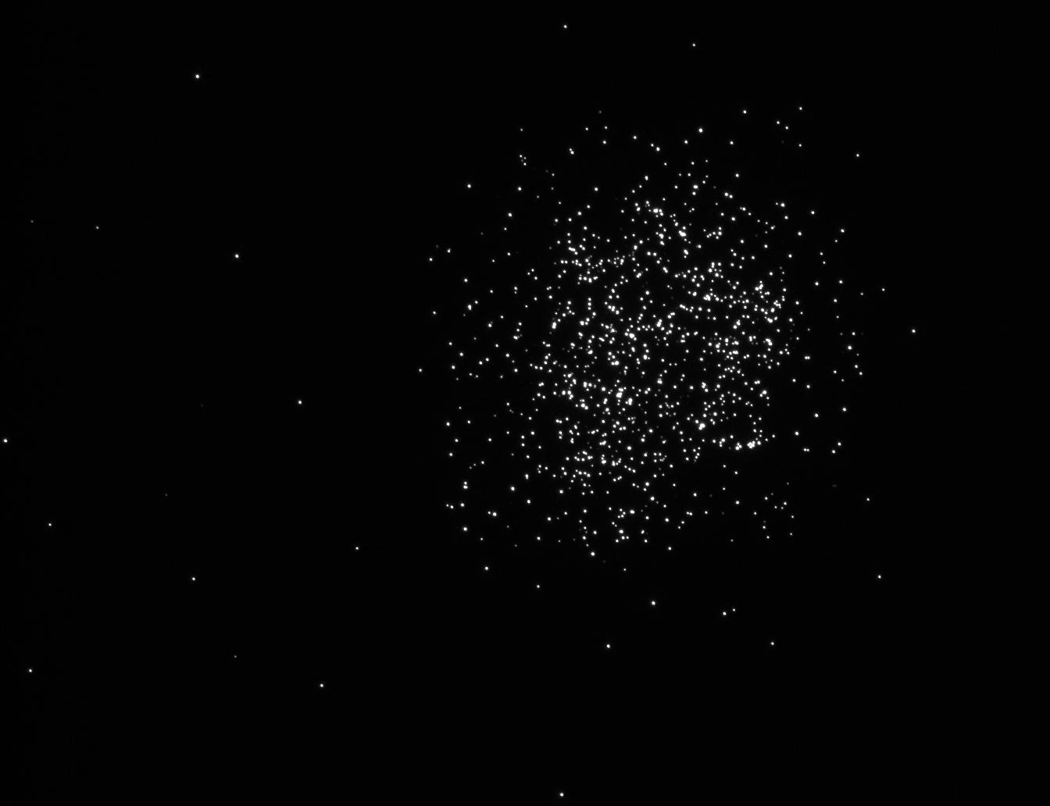
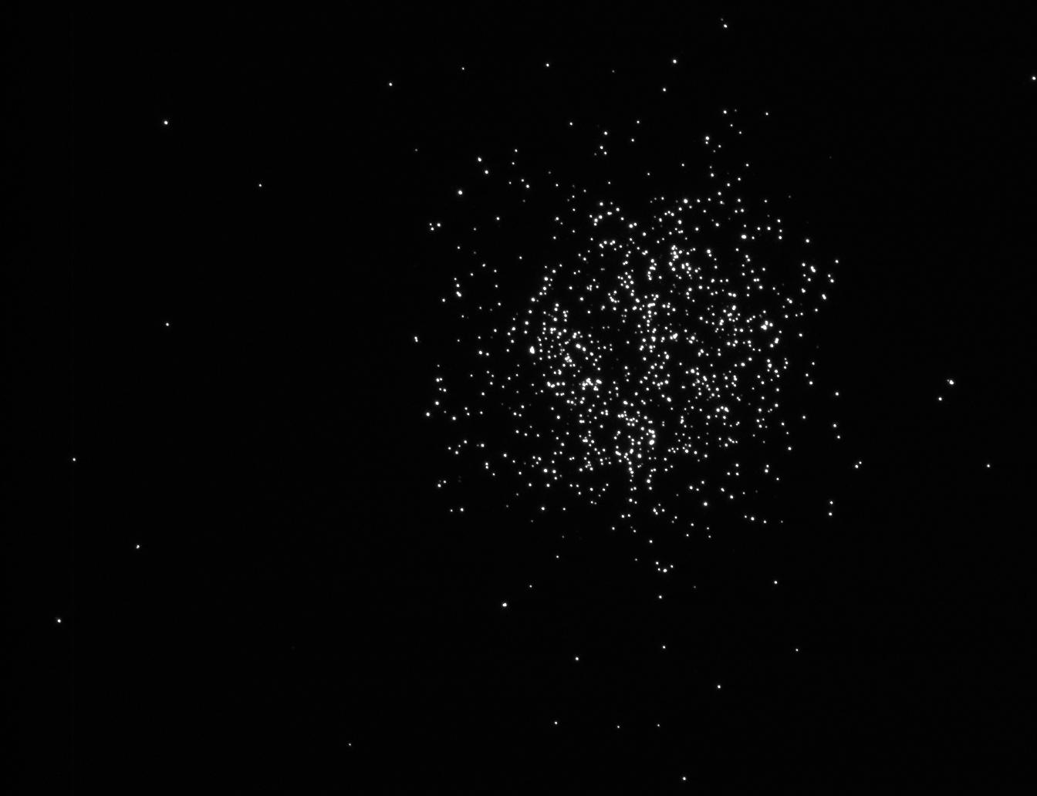

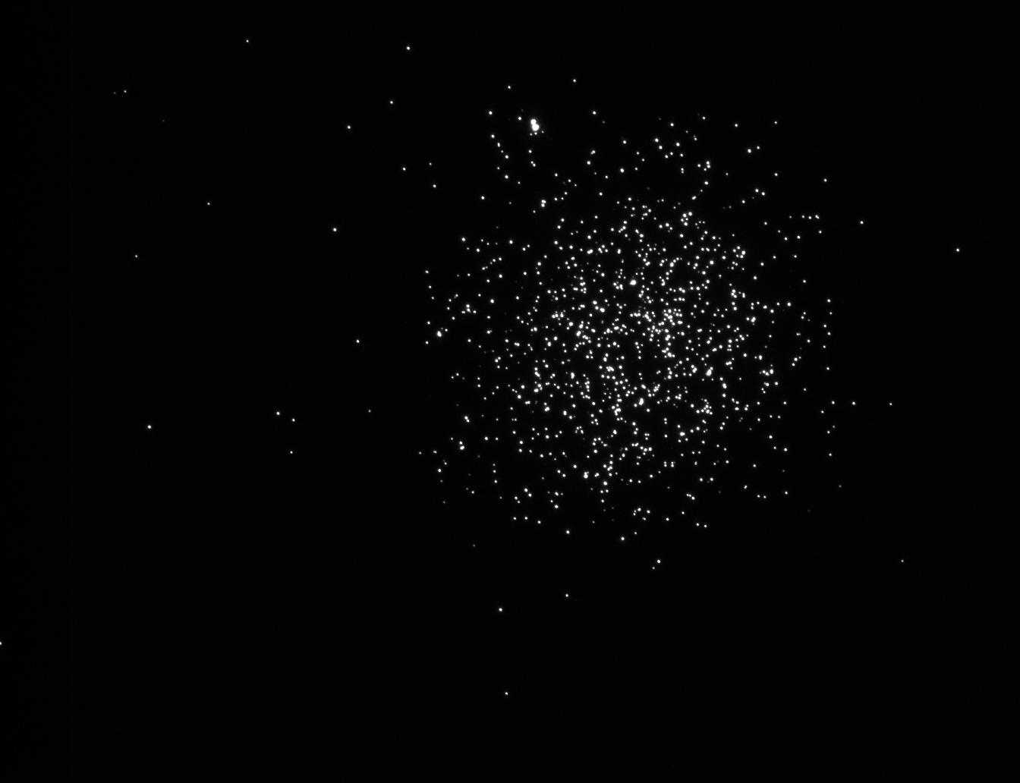
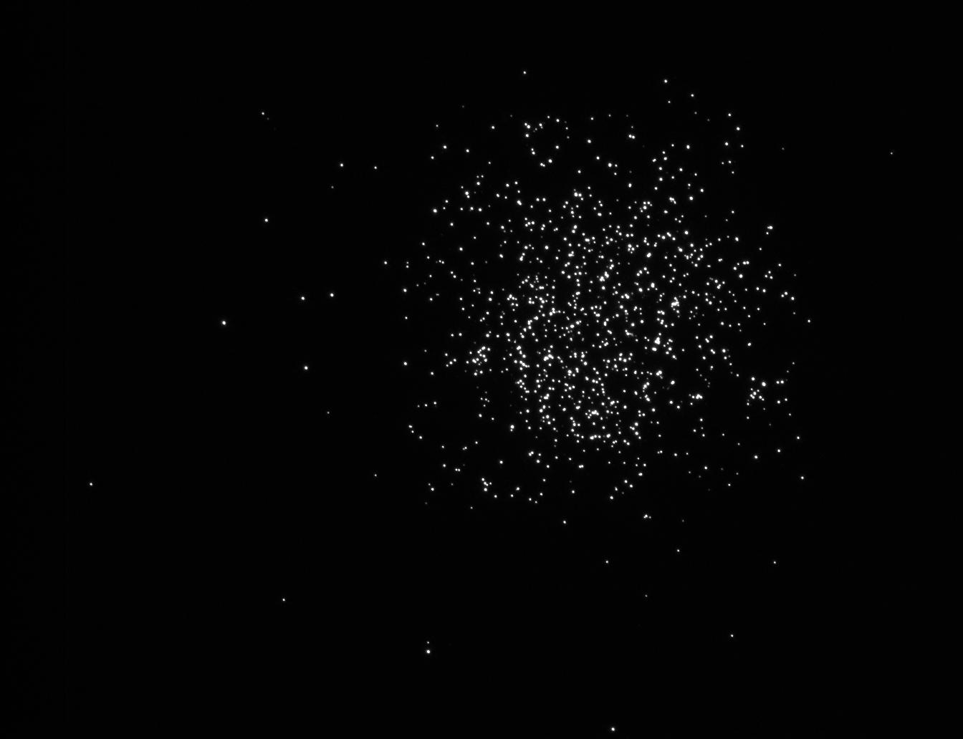
iCCD Laboratory Evaluation 2
Individual frames, 1/30s
Photon-counted Image, 30s
We don’t have much data on this presently-unfunded concept, but the resolution looks in line with expectations.

Slide 23

iCCD Laboratory Evaluation 3
Test target with phosphorescent source
Units are c-px⁻¹-hr⁻¹ for 13um pixel
Limiting dark is 0.2 c-px⁻¹-hr⁻¹
260um
150
1.7
1
Full Frame Photon-counted Image, 30s

Slide 24
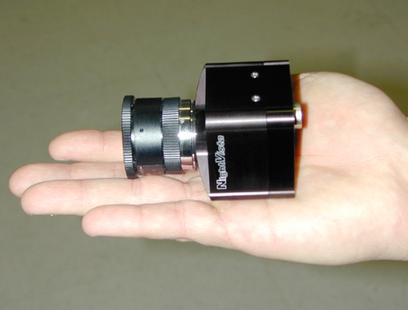
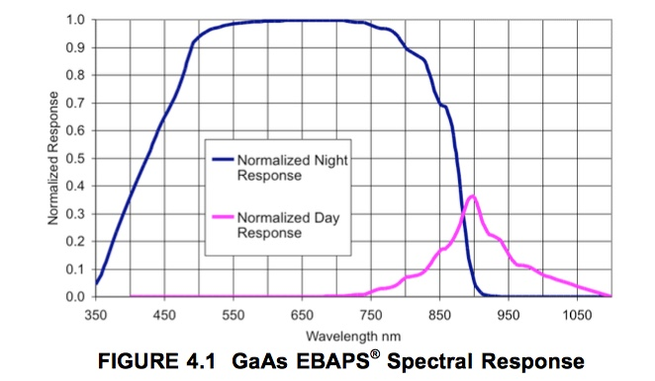
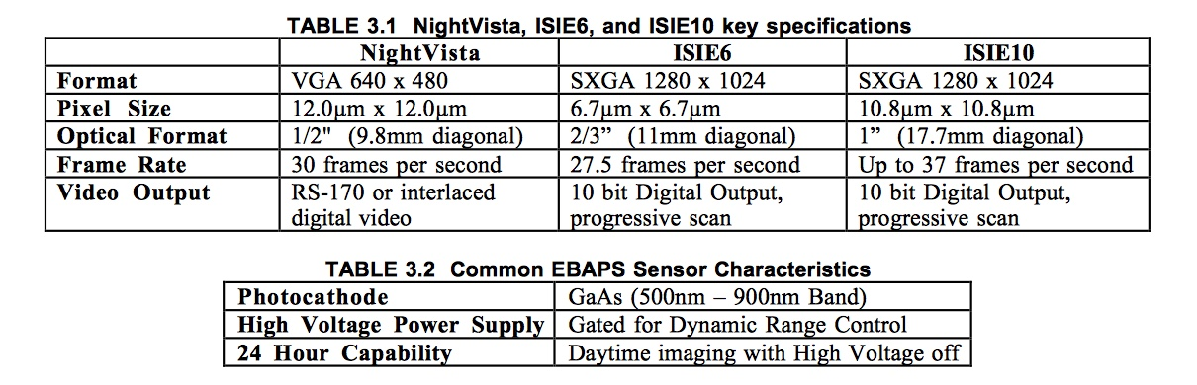
EBAPS Concept
260um
*
Similar GaAs cathode to iCCD but no MCP:
Compact design
Potentially higher QE, better linearity, lower HV

Slide 25
L3CCD BOL/EOL vs GaAs and GaAs(P)
 | PC L3CCD |  | Cathode Designs
 | BOL | EOL | GaAs(P) I | GaAs(P) II | GaAs
Band (QE>20%) | 350-950nm | 350-950nm | 350-700nm | 350-750nm | 450-850nm
Peak QE | 93% | 93% | 50% | 50% | 30%
Charge detection factor | 0.85 | 0.85 | 0.6 | 0.6 | 0.6
Non-linearity factor | 1 | .4 | 1 | 1 | 1
Cosmic ray factor | .992 | .916 | 1 | 1 | 1
dQE | 78% | 29% | 30% | 30% | 18%
CIC (e-px⁻¹-fr⁻¹) | 0.003 | 0.003 | 0 | 0 | 0
Dark (e-px⁻¹-hr⁻¹) | 0.1 | 2 | 0.2 | 0.4? | 0.6?
Cerenkov/Flr (e-px⁻¹-hr⁻¹) | 2? | 2? | 0? | 0? | 0?
Read (e⁻) | 0 | 0 | 0 | 0 | 0
Frame (s) | 10 | 100 | <0.1 | <0.1 | <0.1
Noise (e⁻: 100 hrs, 16px) | 44-71 | 58-81 | 17.9 | 25.3 | 31
dQE/Noise | 1.1-1.8 | 0.36-0.5 | 1.7 | 1.2 | 0.6
260um

Slide 26
MCP Test Program Path Forward
Resolution
Needs to be quantitatively evaluated
High count rate operability
Can the cathode be successfully gated to demonstrate flight-like target acquisition of bright stars (including with planned ND)?
Are bright features/stability of the dark hole problematic?
Dark rate
What is the actual dark rate for the three variants of the GaAs(P) cathode?
Can the dark rate be further improved with a reduction in temperature below -20 ◦C?
Can Cerenkov/fluorescence/cosmic rays be removed effectively with no impact on the detector dark current?
Lifetime
What is the lifetime expectation for the GaAs(P) cathode under realistic illumination conditions, including target acquisition?
Can realistic fault protection protect the cathode against pointing errors?

Slide 27
Outline
Detector Requirements
Contextual summary of L3CCD design and measurements, and HST experience
A primer on risk and detector lifetime with respect to radiation and radiation shielding
Alternate competitive detector concepts
MCP designs
Electron-bombarded CCD/CMOS
Discussion of design maturity and TRL
Pros and Cons
Recommendations

Slide 28
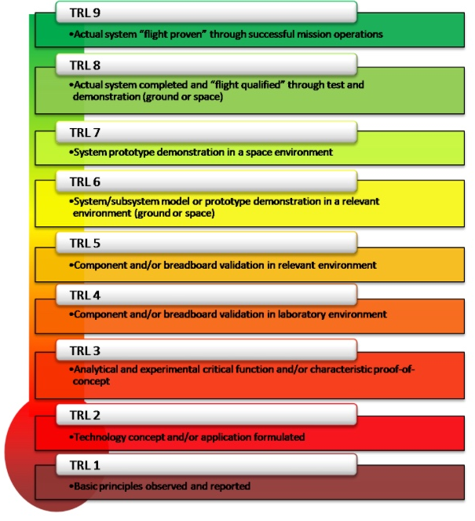
TRL Estimation
iCCD~6 based on SWIFT/MARS2020
 | EBAPS | iCCD/CMOS | SWIFT/XMM UVOT | GALEX | Mars2020 | STIS | SOHO
Band | 400-850nm | 400-850nm | 170-650nm | 120-300nm | 400-850nm | 120-300nm | UV
Cathode | GaAs | GaAs(P) | S20 | CsI/CsTe | GaAs | CsI/CsTe | CsI etc
Readout | CMOS | CCD/CMOS | CCD | Anode | CCD | Anode | CCD and anode
Sealed Tube | ✓ | ✓ | ✓ | ✓ | ✓ | ✓ | ✓
HV | 2kV | 5kV | 5kV | 5kV | 5kV | 3kV | 1-5 kV
Operating Temp | -20 ￮C | -20 ￮C | +20 ￮C | +20 ￮C | 0 ￮C | +20 ￮C | +20 ￮C
Launch date | N/A | N/A | 2004 | 2003 | 2020 | 1997 | 1995
Mission? | N/A | N/A | Operating | 10 years | N/A | Operating | Operating
EBAPS TRL~4?
The closest proxies to the proposed iCCD/CMOS backup are the successful NASA SWIFT and ESA XMM Newton. Both are photon counting iCCD detectors identical in concept but with UV-optical S20 cathodes instead of the optical-NIR GaAs(P) cathode. The forthcoming Mars2020 SuperCam uses a sealed MCP intensifier with a GaAs cathode.

Slide 29
Outline
Detector Requirements
Contextual summary of L3CCD design and measurements, and HST experience
A primer on risk and detector lifetime with respect to radiation and radiation shielding
Alternate competitive detector concepts
MCP designs
Electron-bombarded CCD/CMOS
Discussion of design maturity and TRL
Pros and Cons
Recommendations

Slide 30
iCCD/CMOS PROS and CONS
PROs
The iCCD/CMOS design is likely to behave in flight the same as measured on the ground, and to not change significantly over time. It is rad-hard.
The iCCD/CMOS will exhibit the same linear response at beginning and end of mission (within the flux range of interest)
Designs that are nearly identical have flown (and are currently operating), providing an excellent baseline to establish performance expectations.
The iCCD/CMOS design can be framed rapidly, allowing Cerenkov and fluorescence light (but not phosphorescence) to be filtered.
The GaAs(P) cathodes exhibit very low dark current
Cooling is only required to -20 to -30 ◦C (vs -100 ◦C L3CCD).
Long lifetime may enable a starshade application at T+6-9 years
CONs
The iCCD/CMOS can’t match the BOL L3CCD performance, particularly in the RED.
The iCCD has lower QE than the L3CCD across the spectrum.
High Voltage is required
Careful planning for acquisition, operations, and fault protection is required.

Slide 31
Outline
Detector Requirements
Contextual summary of L3CCD design and measurements, and HST experience
A primer on risk and detector lifetime with respect to radiation and radiation shielding
Alternate competitive detector concepts
MCP designs
Electron-bombarded CCD/CMOS
Discussion of design maturity and TRL
Pros and Cons
Recommendations

Slide 32
Recommendations
The L3CCD is a novel new photon counting detector with high QE that is baselined for the WFIRST coronagraph. The detector has demonstrated a significant degradation in performance due to radiation damage at the JPL-recommended test level (2x95% confidence level). The log-normal nature of the solar radiation dose means the most likely fluence is substantially lower.
R1: The science team should carefully evaluate the implications of the measured L3CCD performance and provide feedback on the requirements for a successful mission.
R2: The instrument team should further invest in the L3CCD technology to improve its performance in a radiation environment over the expected mission life.
R3: The instrument team should invest in reduced-level L3CCD radiation testing in order to better understand the performance risks at more likely exposure levels.
The MCP detector has been around for decades and has a well-established heritage of successful space flight applications. Even though it has lower QE, its performance is competitive with the L3CCD for wavelengths < 750nm because of its low background, which is not expected to change over the mission.
R4: The Project should consider investment in a commercial iCCD system that can be evaluated prior to PDR as a risk-reducing backup to the L3CCD.
The EBAPS detector is a recent development with similar performance expectations to the MCP (perhaps with improved dQE, linearity and contrast), while providing operation at ~1/3 the voltage of the MCP in a compact, single-piece package.
R5: The EBAPS detector is a promising technology that could be evaluated by JPL as part of a general enhancement of photon counting detector expertise, but likely is too immature at this time to provide a compelling alternative to the iCCD/iCMOS design.

Slide 33
References
Aebi et al, “EBAPS: Next Generation, Low Power, Digital Night Vision,” OPTRO 2005
“Fordham et al, “Development of the MIC Photon Counting Detector for Astronomical Applications,” SPIE 1990
Hutchings et al, “Photon Event Centroiding with UV Photon-counting Detectors,” PASP 2007
Janesick, “Scientific Charge-Coupled Devices,” SPIE Press 2000
Kumar et al, “Ultra Violet Imaging Telescope (UVIT) on ASTROSAT,” SPIE 2012
Morrissey et al, “A Photon Counting Intensified CID for Space Astronomy,” SPIE 1998
Roming et al, “The Ultra-Violet/Optical Telescope of the Swift MIDEX Mission,” SPIE 2000
Smith et al, “Radiation Effects in Astronomical CCD Images,” SPIE 2002
Wide Field Camera 3 Instrument Handbook for Cycle 24, StSci, Version 8. 2016

Slide 34
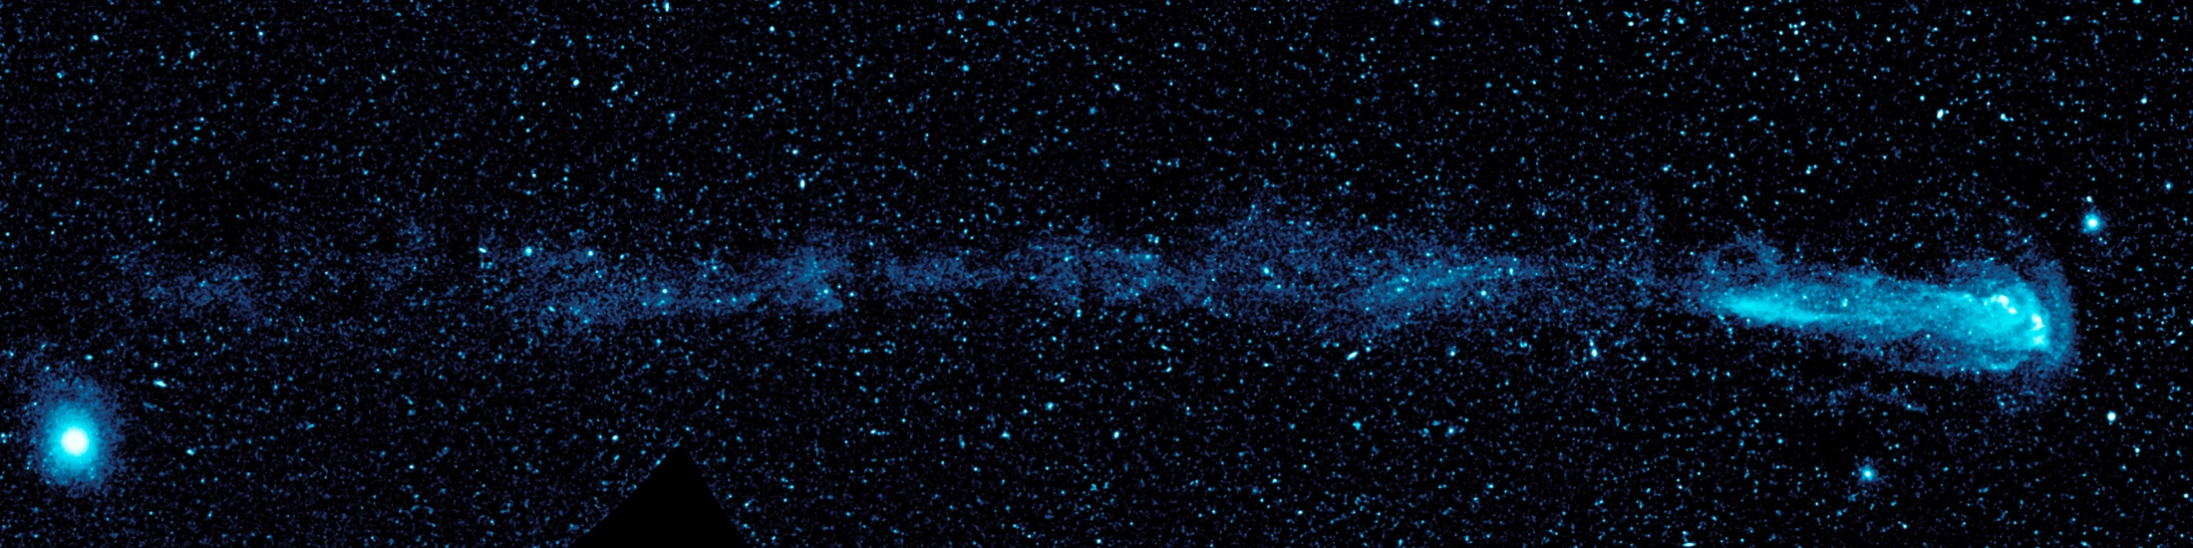
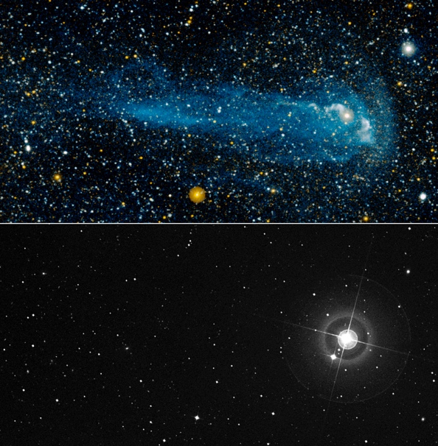
Mira
Ultraviolet
Visible

Slide 35
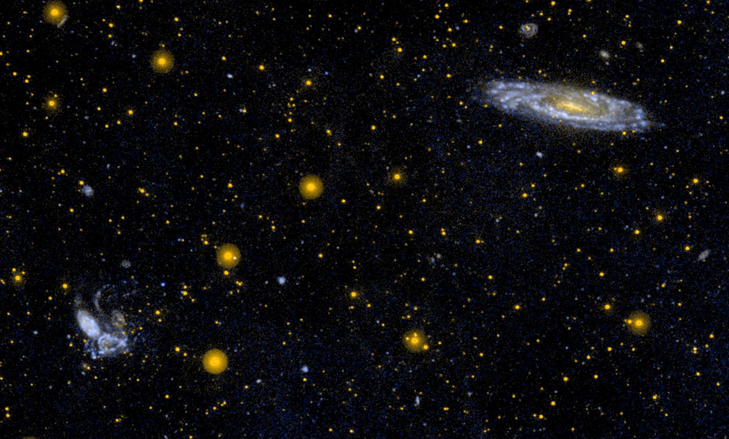
Stephan’s Quintet

Slide 36
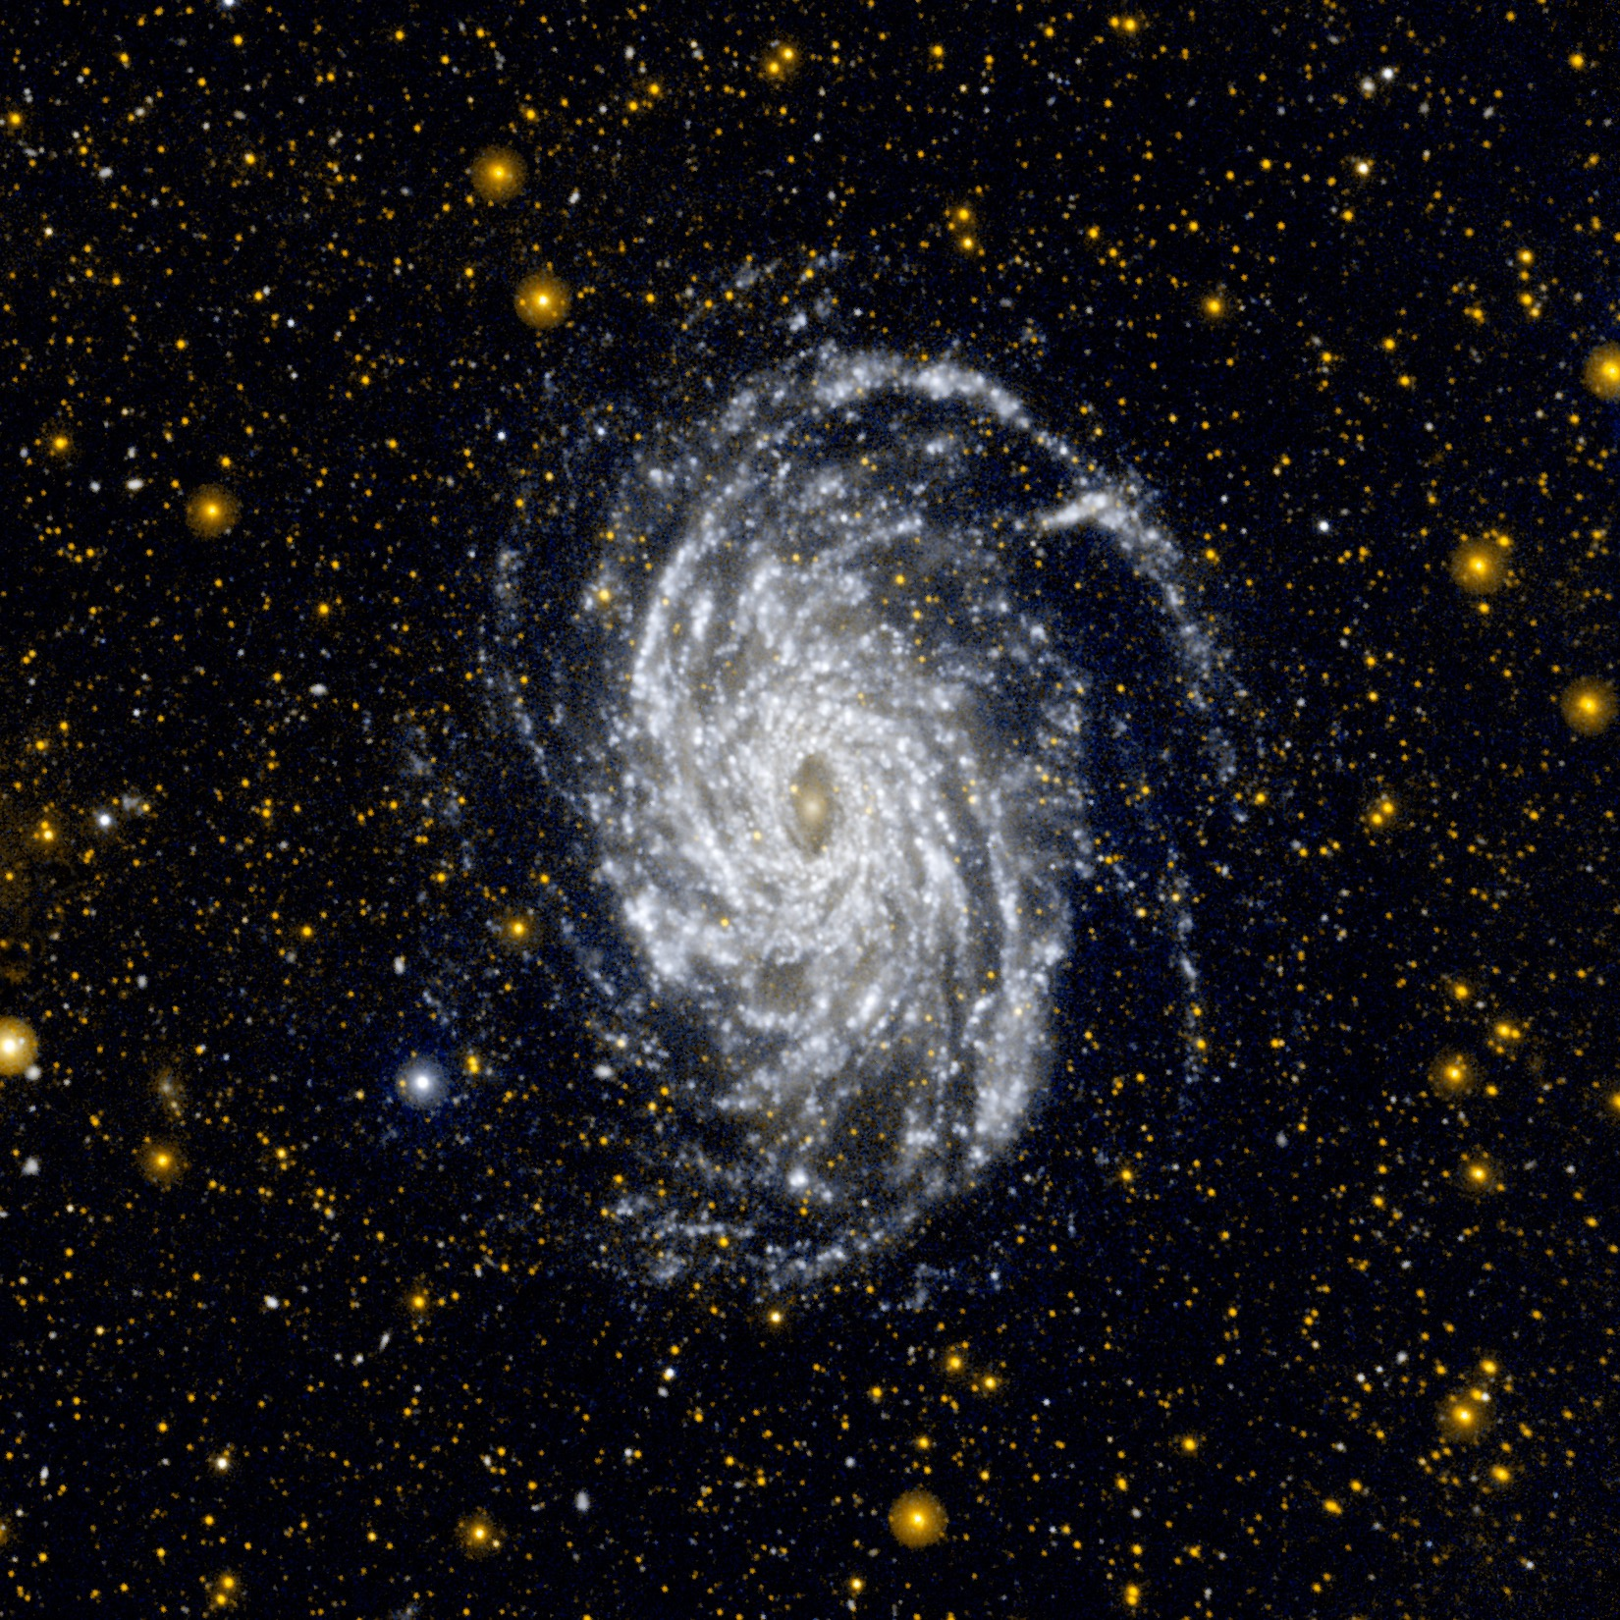
NGC6744

Slide 37
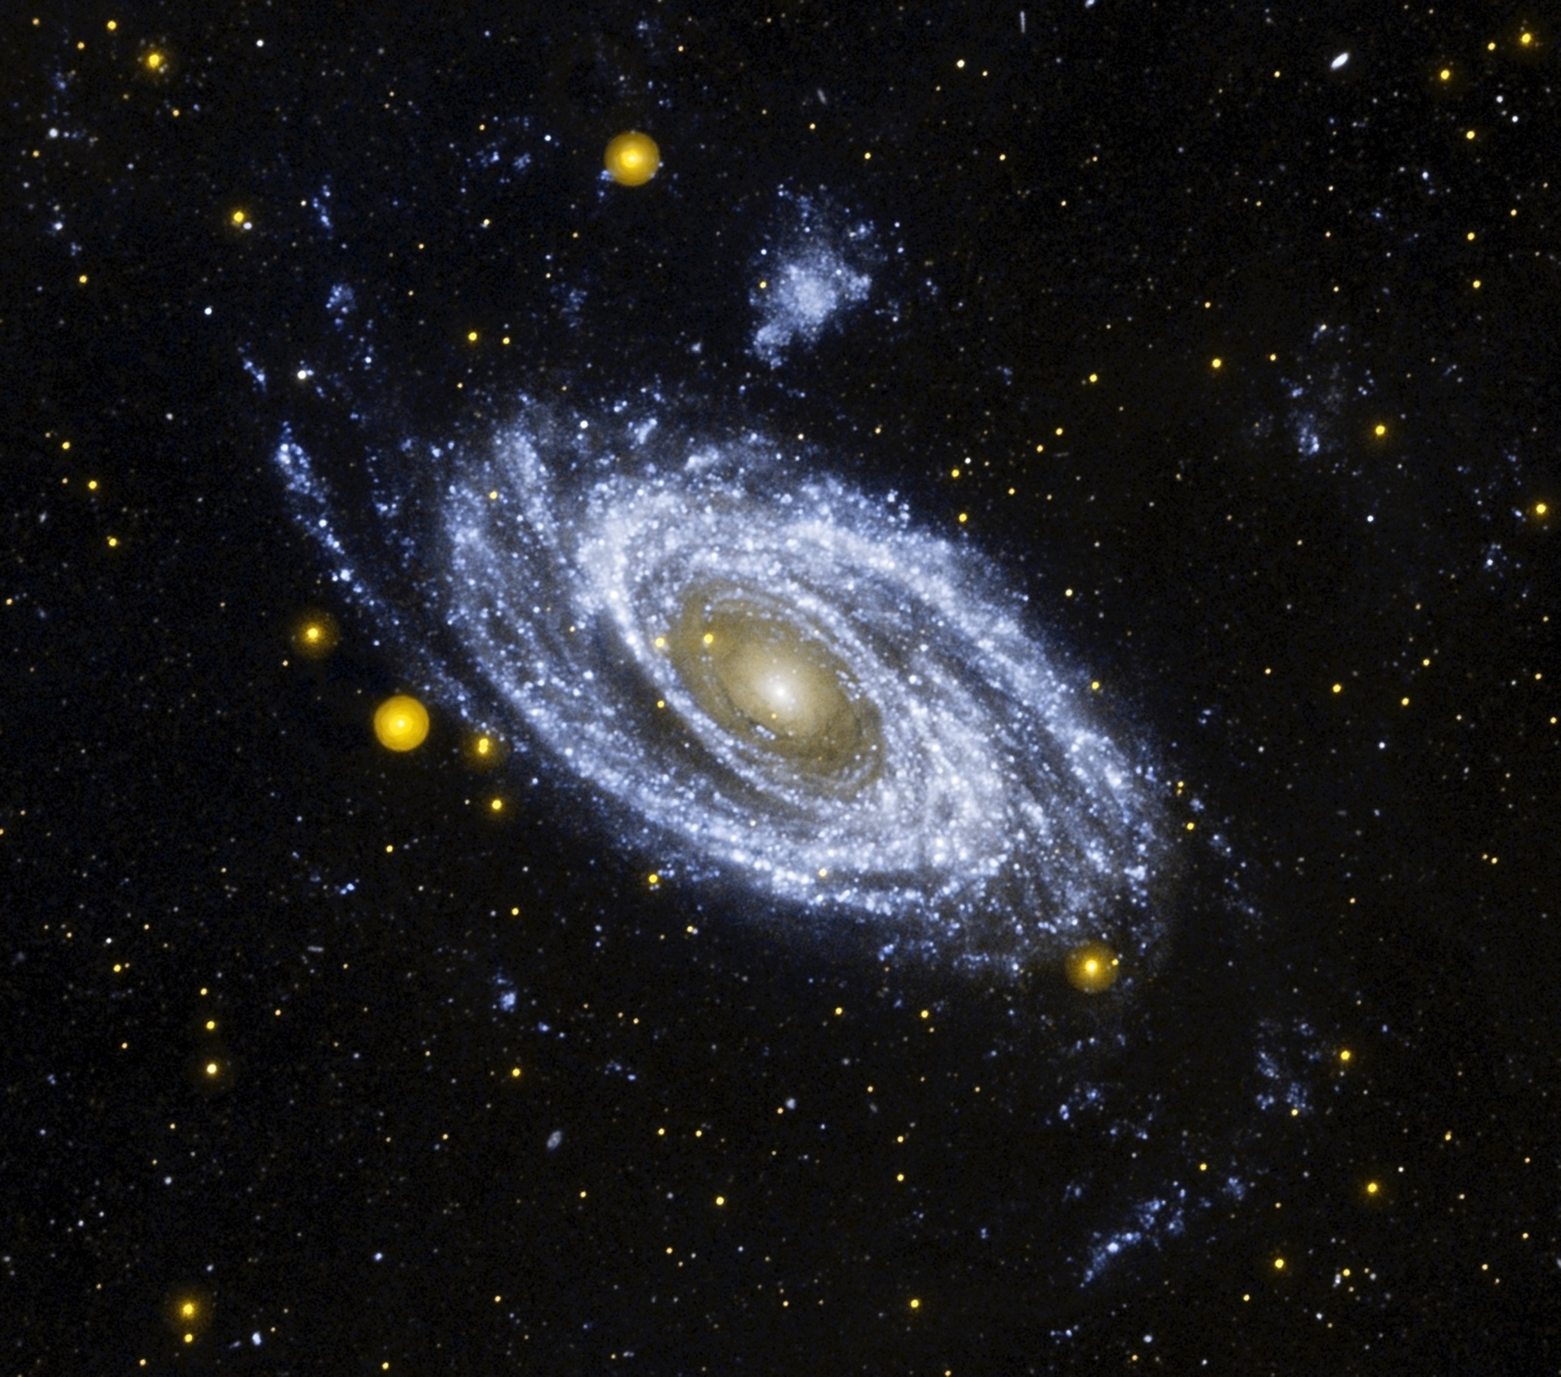
M81

Slide 38
Backup

Slide 39
Some Alternate Detectors
 | CMOS | EMCCD | MCP-Intensified CMOS/CCD | MCP-Anode Readout
Format | 1kx1k, 2kx2k | 1kx1k, 2kx2k | 18, 40mm standard | GALEX 70 mm
Resolution* | ~12 μm | ~25 μm | ~25 μm | 40 μm
Read noise | ~1-5e⁻ | 0 | 0 | 0
Dark current | Si | Si | Cathode | Cathode
Rad-hard | Yes | No | Yes | Yes
Cryogenic | Yes | Yes | No | No
High Voltage | No | No | Yes | Yes
Flight heritage | ✘** | ✘ | ✔ | ✔
*Resolution is FWHM or 2 pixels
**There is currently no flight experience with CMOS requiring 1e- measurements
Highest QE
Good Resolution
Lowest Noise
Most Rugged
Also EBAPS

Slide 40
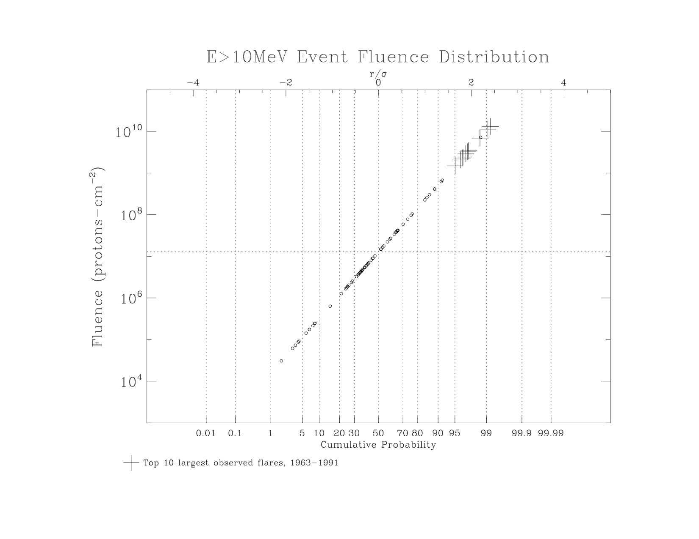
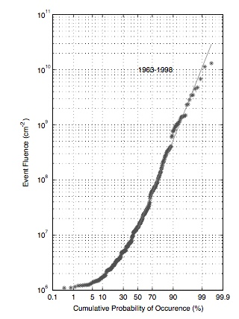
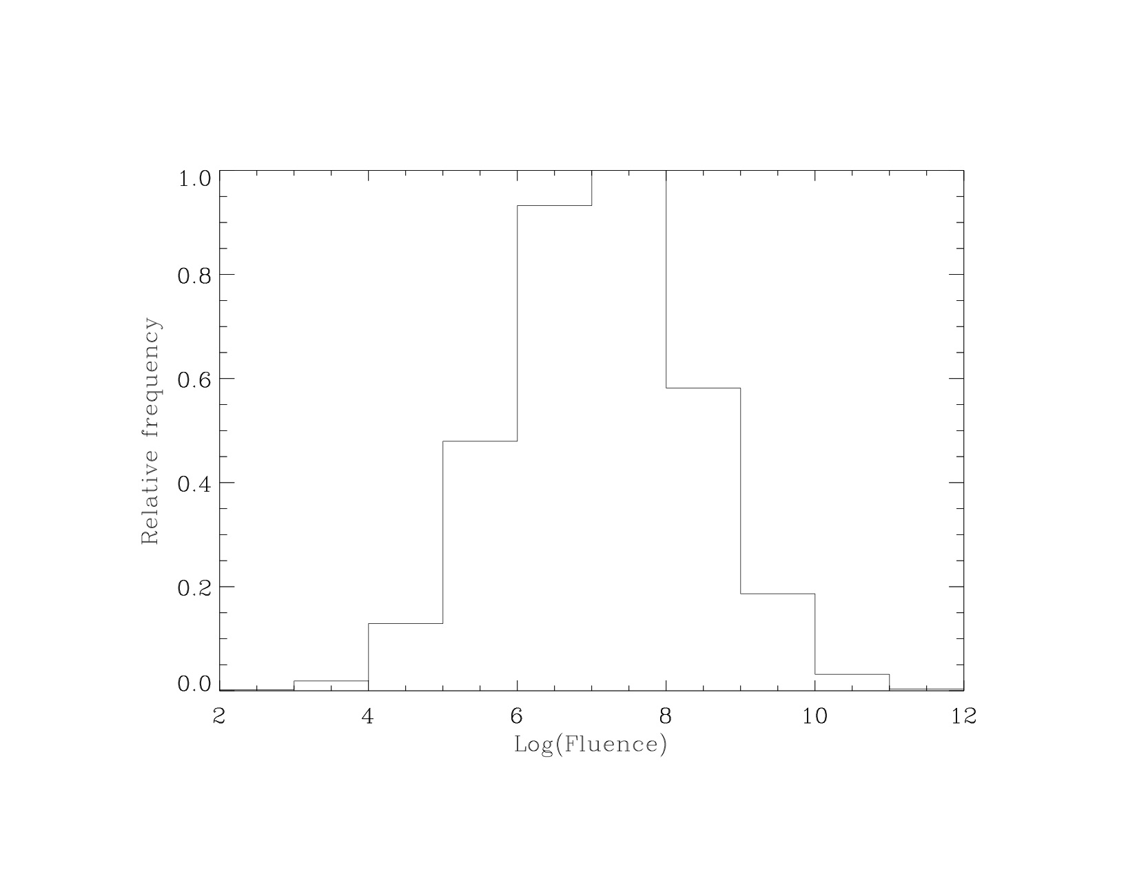
10 Largest
Observed Flares
Feynman 2002
(35 years of data)
Log-normal Model
Distribution
~68 flares in 7 years

Slide 41
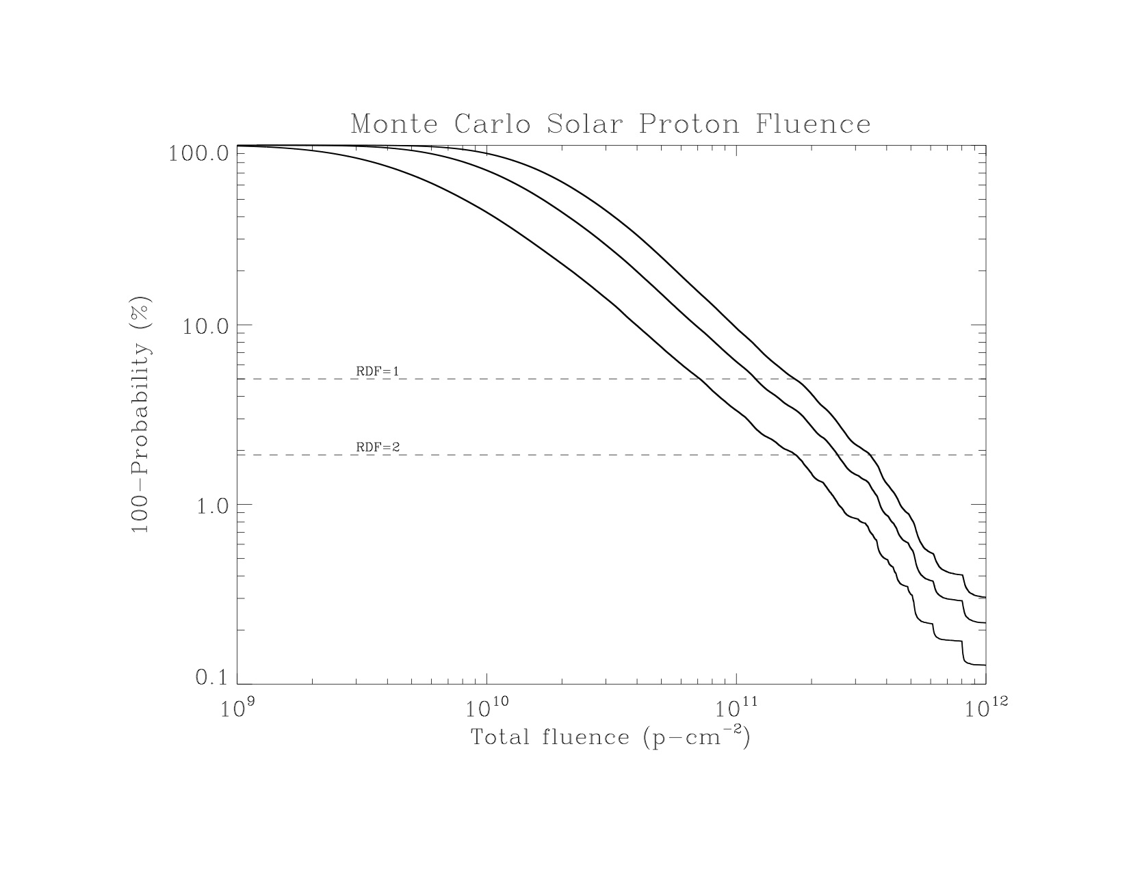
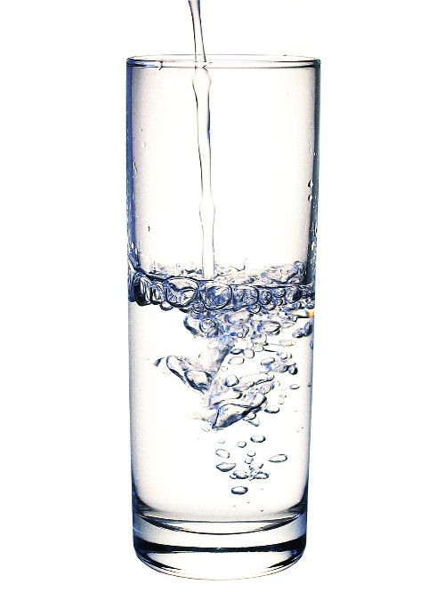
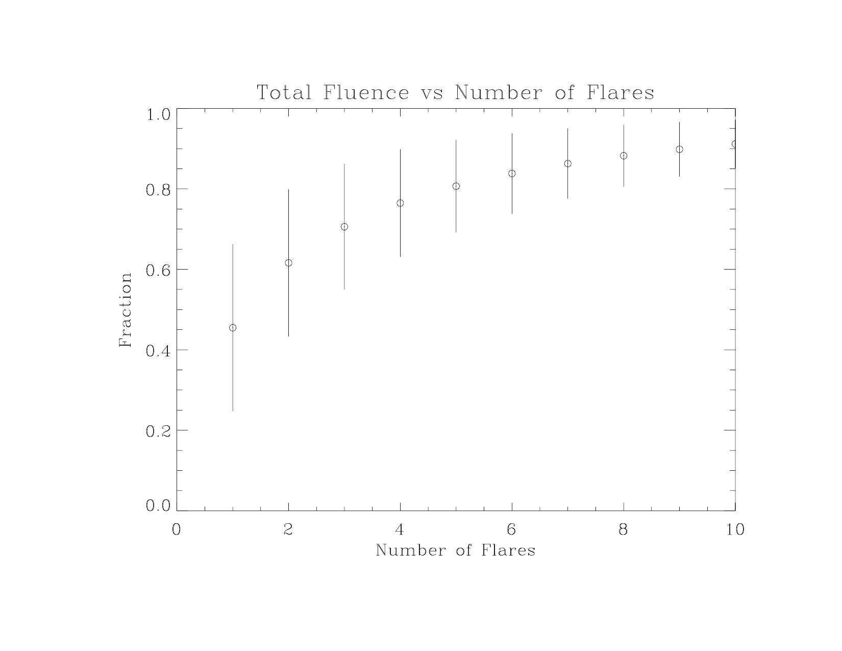
Half empty or half full?
How conservative is the test level?
7 years
5
3 years
95% confidence
98% confidence
Most L2 CCD damage will likely result from just 1-5 flares in a solar cycle, and these flares may occur any time during the 7-year active period.

Slide 42
Cerenkov Radiation and Phosphorescence
High energy particles (cosmic rays) travelling through matter radiate with a blue glow from the Cerenkov effect. In space, this can produce an undesirable background in an integrating detector such as the EMCCD.
The direct imaging channel currently has a protective fused silica window in front of it that will produce Cerenkov light.
The IFS has a thick CaF₂ lens close to the CCD that will also produce Cerenkov light.
CaF₂ is also known to be a potential source of phosphorescence
Preliminary estimates are that Cerenkov light in the DI window will enhance the EMCCD detector dark current, and may dominate the background in the IFS.
A readout faster than the cosmic ray rate can successfully mitigate Cerenkov (>>10fps).
Nuclear Reactor
Cerenkov Glow

Slide 43
Shielding Experiments
Smith et al SPIE 2002:
Particle track shapes in a thick CCD can distinguish radioactive decays from muons.
Muon energies are of order GeV, while radioactive decay gammas are of order MeV.
The muon rate was unaffected by 1.5m of low background cement shielding
The muon rate was affected by 480 meters (!) of water

Slide 44
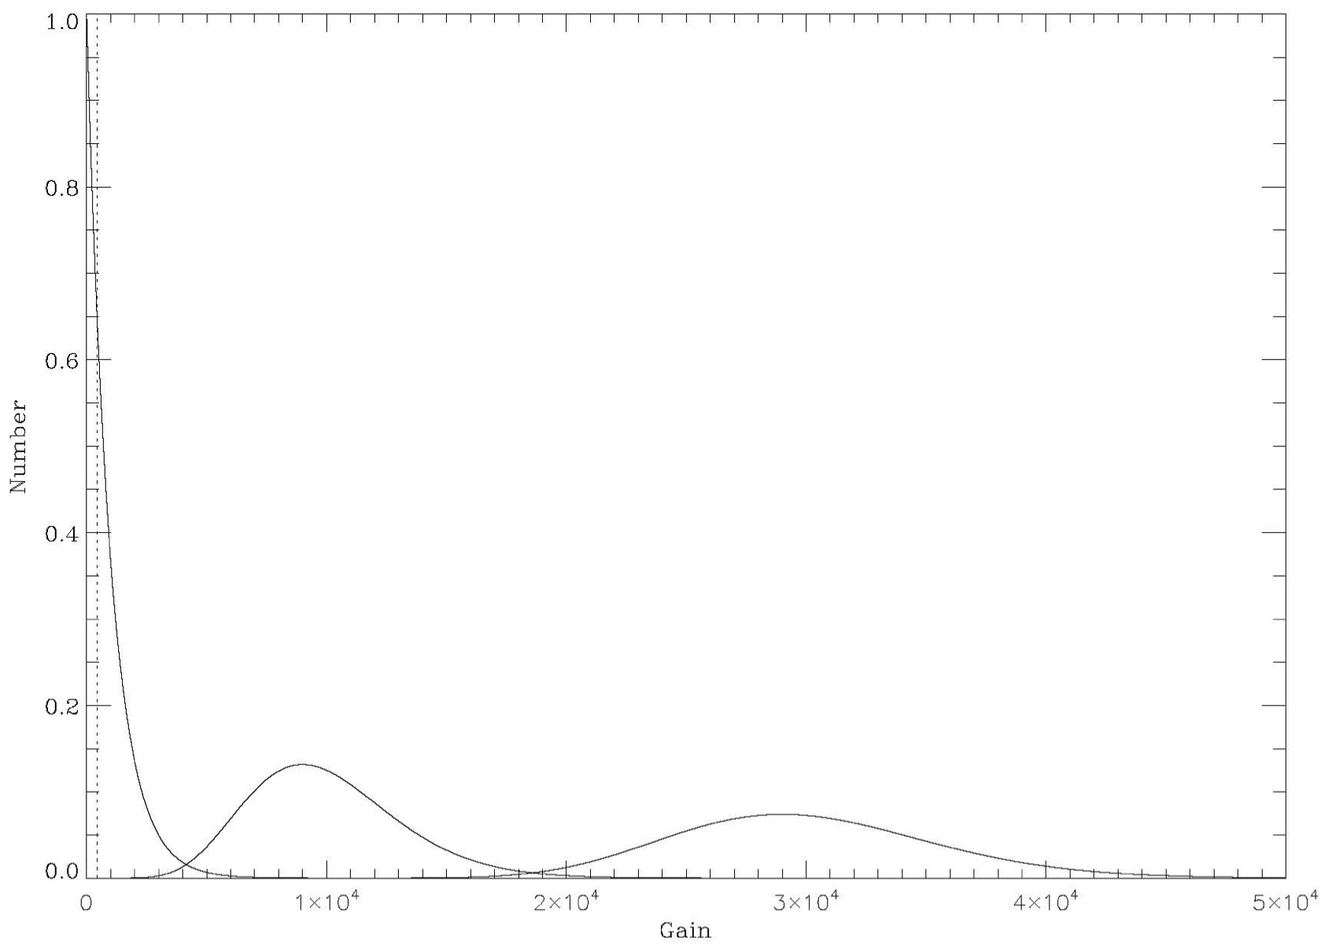
Theoretical Considerations
3 input cases with mean gain of 1000x
Does NOT include photon shot noise
In: 1 e⁻
Out: 1000 e⁻
10% <200 e⁻
25% <300 e⁻
50% <700 e⁻
At current noise levels, threshold = 450 e⁻
In: 10 e⁻
Out: 10000±3012 e⁻
In: 30 e⁻
Out: 30000±5391 e⁻
See Basden 2003

Slide 45
HST WFC3 Experience: Dark Current
WFC3 Instrument Handbook

Slide 46
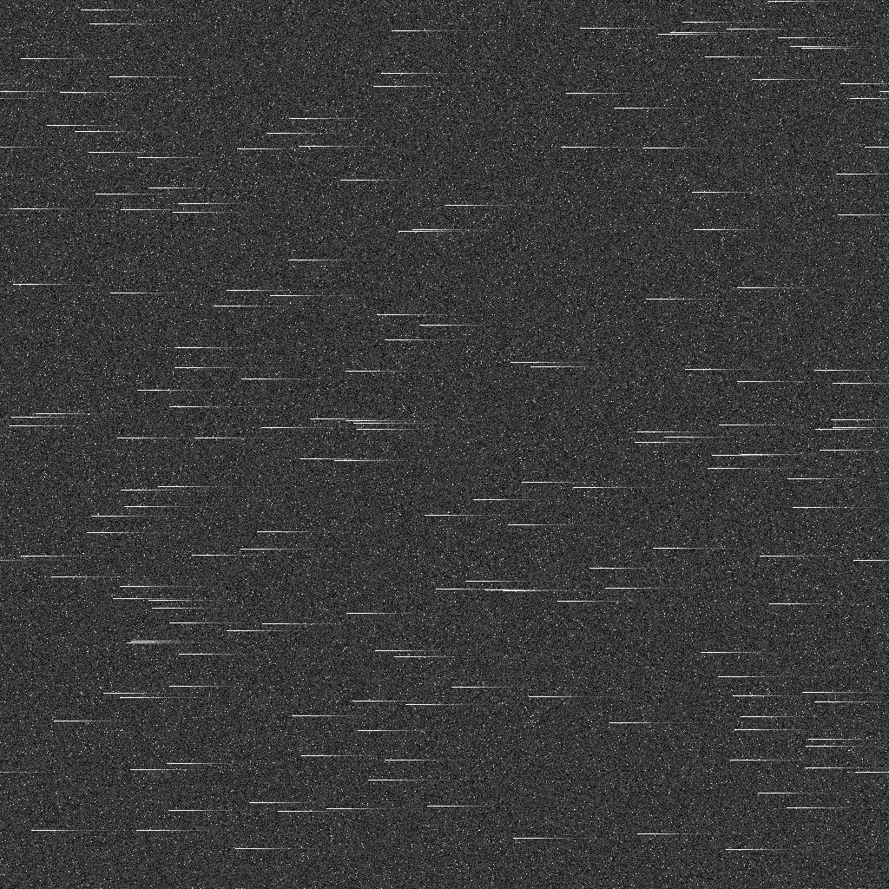

Cosmic Ray Consequences
Exposure: 20s
170 CRs (~4% pixels)
Exposure: 2000s
17000 CRs (100% affected)
The expected L2 CR flux of 5 cm⁻²-s⁻¹ combined with >100 pixels of EM register smear has very important consequences for the EMCCD:
Frame times must be short (<100s)
Read noise and CIC become relatively more important
Photon counting is required to overcome these noise sources.
Low level CTE becomes a critical performance parameter

Slide 47
EMCCD Radiation Damage
Radiation damage is a major focus of the JPL program to qualify EMCCDs for flight. Testing is underway, but the likely outcome is that a careful effort will be required to shield the EMCCDs during the 6 year WFIRST mission.
Shielding yields diminishing returns beyond a certain point.
Considerable experience from HST is available on the consequences of radiation damage in thin silicon CCDs much like the CCD201.
Experience from the HST WFC3 shows that faint object detections are vulnerable to traps created in the silicon by energetic particles.
Traps capture the charge they need to be satisfied (additive), allowing a large fraction of high signal events to proceed.
Traps capture the entire signal from an EMCCD detection (never more than 1 e⁻). This trapped signal will be released at a later time, displacing the detection and lowering the signal-to-noise ratio in the process.

Slide 48
EMCCD Dark Current
The EMCCD can in principle achieve very low dark current, and this is required to make detections at the low levels we anticipate. At -85 °C, dark current (~2 e⁻-pixel⁻¹-hr⁻¹) is the limiting source of noise in the photon counting EMCCD.
Efforts to drive the dark current to extraordinarily low levels have been thwarted by degraded CTE, which smears images as the detectors are cooled below about -110 °C.
Dark variability has been observed with a power cycle or bright illumination that exposes surface traps. This enhanced dark (~10x) may take hours to decay.
The high frame rate constraint imposed by cosmic rays places a CIC noise floor of about 0.14 e⁻-pixel⁻¹-hr⁻¹ regardless of the dark current that may be achieved.
HST experience shows that the dark current can be expected to rise steadily in flight as the device is exposed to radiation.
Dark current and hot pixel enhancement in flight is typically mitigated by monthly “anneal” cycles during which the detector is warmed to 20 °C. This anneal cycle is likely to be required by the WFIRST EMCCD and may be a ~10% burden on operational efficiency.

Slide 49
EMCCD Red Fringing
The EMCCD is fundamentally a thin silicon CCD like any other. Silicon becomes transparent at long wavelengths (>700nm), which is why red sensitive CCDs use much thicker substrates (~10X) than the CCD201, at the expense of higher noise and lower resolution.
Red light “etalons” inside the 10 𝛍m silicon CCD epitaxial layer, causing interference fringes that are a function of the incident light bandwidth, position and focal ratio.
The effect of fringes may have a significant impact on the interpretation of integral field spectra, which will be distributed all across the detector.
The HST WFC3 employs a thin e2v CCD that is in many respects similar to the CCD201. The WFC3 instrument handbook reports ~30% fringing at the longest red wavelengths.
HST WFC3 977 nm

Slide 50
Results: PC vs Analog Mode
5000 frames, 20s/frame PC
5000 frames, 20s/frame AM
15e⁻
1e⁻

Slide 51
Surface Charge Trapping in an EM Register
EM Register Pixel
Courtesy N. Bush, CEI
Image pixel

